Slide 1
Leading the way to
technology accessibility
Washington State
Community and Technical Colleges
Better Jobs, Brighter Futures, a Stronger Washington
Notes:
I’m with CATO, the Committee for Accessible Technology Oversight and I’m here to ask for your help. We have been charged by WACTC Tech with developing a proposal by this May for leveraging our system’s resources to address accessibility testing requirements and remediation in a cost-effective, equitable and responsive manner. So why has WACTC given us this charge?

Slide 2
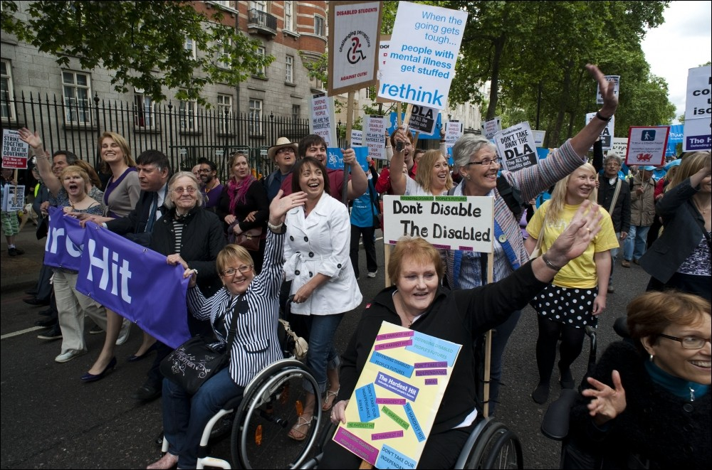
Notes:
We are committed to diversity, equity and inclusion and technology accessibility is a civil rights issue

Slide 3
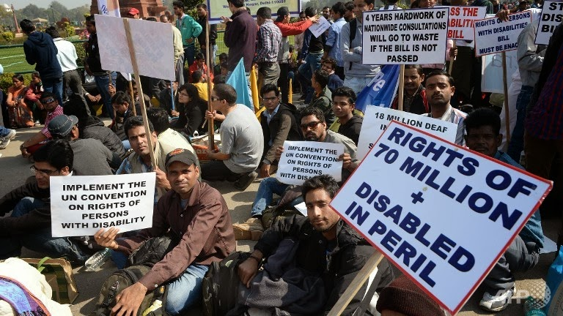
Notes:
Unfortunately our technology and the way we use it can marginalize members of our community . .

Slide 4
12% of community college students have a disability
Notes:
About 12% of college students have a disability and the numbers are similar for faculty and staff

Slide 5
only half will self-identify as disabled
Notes:
Its often a hidden disability – only half of those who are disabled will identify themselves

Slide 6
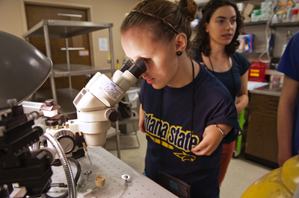
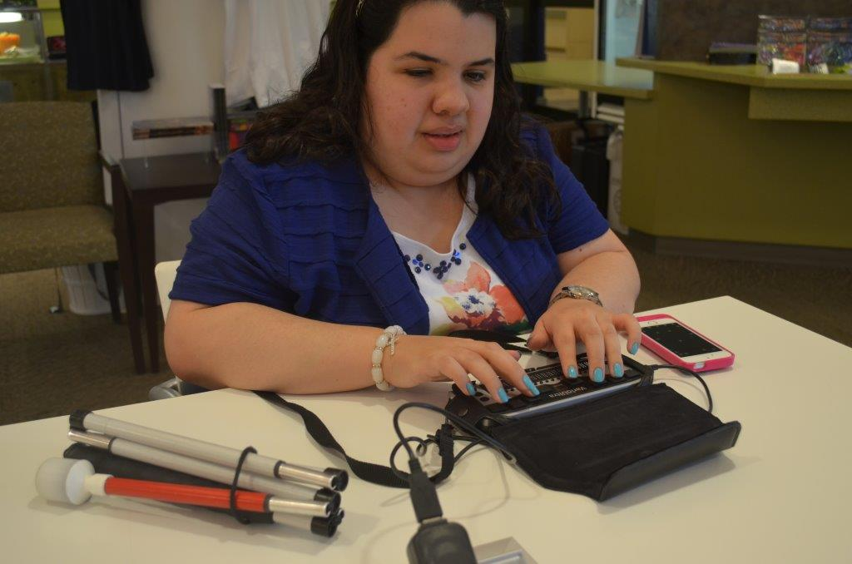
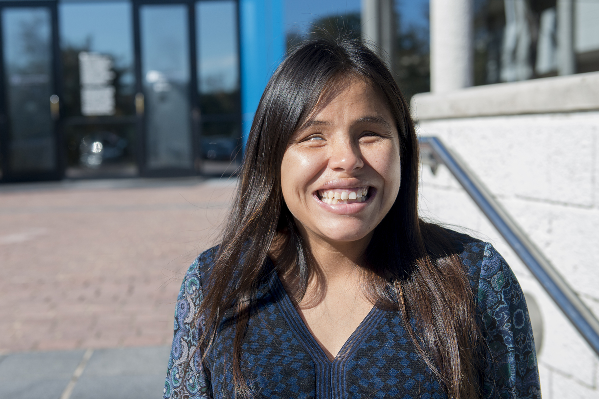
12,414
of our students self-identify as disabled
Notes:
Even so, that represents over 12,000 students, the equivalent of Tacoma Community College. That’s why the State Board passed its policy on technology accessibility

Slide 7
“equal, effective, and meaningful access to the benefits of technology for individuals with disabilities”
Notes:
Which committed our system to providing equal, effective and meaningful access to the benefits of technology for individuals with disabilities.

Slide 8
Notes:
In addition the OCIO of the State of Washington recently issued Policy #188, which requires all state agencies to develop plans to make their technology accessible- and the plans have to set deadlines for achieving accessibility goals.
These policies reflect our commitment to equity and inclusion, but there is another reality as well and that is . . . The increasing degree to which institutions are being held legally and financially accountable for their failure to meet the Section 508 provisions of the American Disabilities Act. As you can see, its not an isolated phenomenon

Slide 9
Atlantic Cape Community College
Arizona State
BarBri
California State Community Colleges
Capella University
Case Western Reserve
Finlandia
Florida State
Fordham
Harvard
LA Community College District
Louisiana Tech
MIT
McNeese State University
Mesa Community College and Maricopa
Miami University (Ohio)
Mt. Hood Community College
NYU
North Carolina State
Northwestern University
Ohio State
Pace University
Princeton
Penn State
Reed
Siskiyou Joint Community College District
South Carolina Technical College System
UC Berkeley
University of Cincinnati
University of Colorado
University of Kentucky
University of Maryland
University of Montana
University of Phoenix
University of Virginia
Youngstown State
Notes:
The Office of Civil Rights of the US Department of Education has taken institutions to task for their failures and the courts have awarded monetary damages. There are some big names on the list, but some are in our league

Slide 10
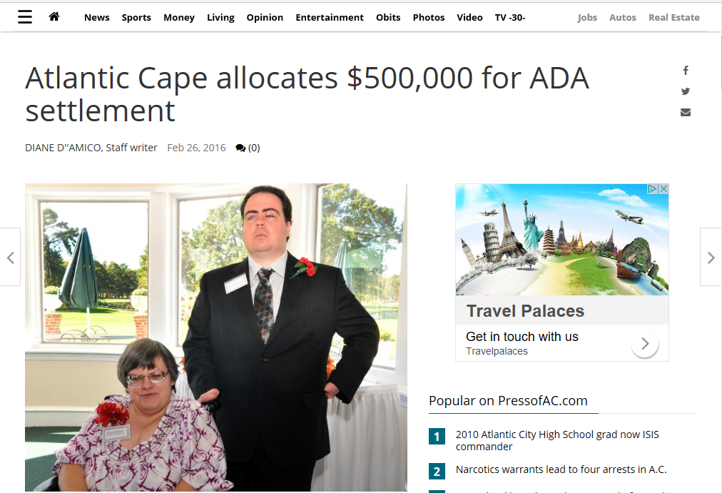
Notes:
For example it cost Atlantic Cape Community College $500,000 in legal and settlement fees to address the lawsuit brought by these two students. That does not include the cost of all the work that needed to be done to bring the college into compliance with disability regulations.

Slide 11
Current State
Notes:
So where do we stand today as a system in terms of technology accessibility?

Slide 12
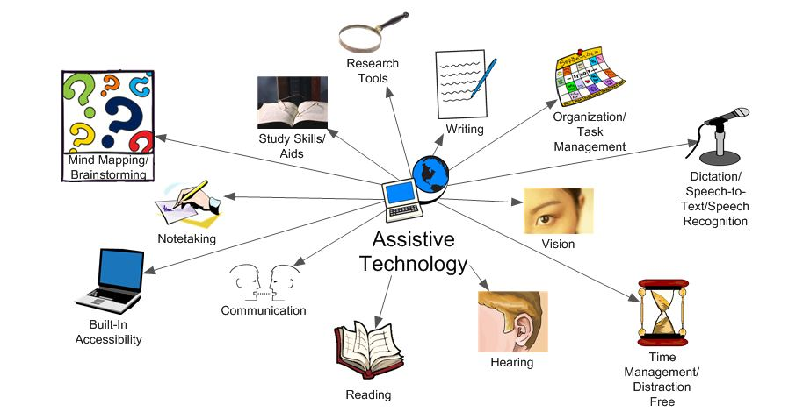
Notes:
We do a lot in the way of responding to the needs of students with disabilities by providing them with assistive technology.

Slide 13
Accommodate
Notes:
I short, we accommodate them, which is to say that we react to their needs, rather than proactively addressing those needs. This is more or less the way physical access was addressed immediately after the American Disabilities Act was passed - a lot of access ramps were added

Slide 14
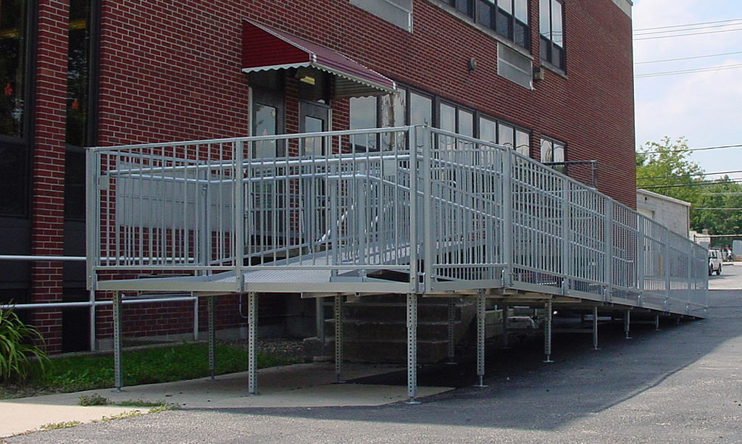
Notes:
On to buildings. Like this one, they were an afterthought, and it showed.

Slide 15
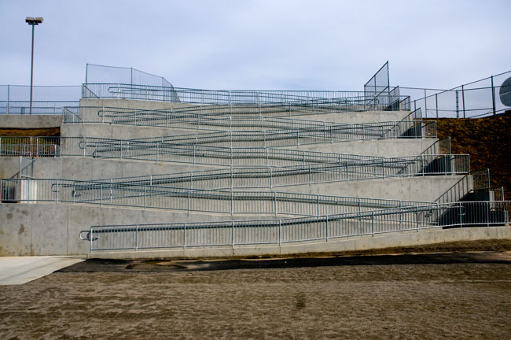
Notes:
When new structures were built that attitude carried over a while – this ramp was built to meet the letter of the ADA’s legal requirements, its design is reflective of the fact that designing to meet everyone’s needs was not part of the culture. Architects have now made the cultural shift to universal design . . .

