Slide 1
Development of a BASBH common course numbering system

Slide 2
BASBH education context
Edmonds College
Lake Washington
Institute of Technology
Wenatchee Valley College
Seattle Central College
Peninsula
College
Big Bend College
Olympic
College
Spokane Falls CC
Centralia College
Yakima Valley College

Slide 3
Expected benefits of a CCN
Facilitate student transfer
Influence new BHSS credential
Facilitate new program development
Sharing of curricular resources
Sharing courses across schools (simultaneous enrollment by students from multiple schools)
Graduate school familiarity with our programs
Facilitate industry understanding of student transcripts
Notes:
Not essential. Not necessary. But possibly helpful.

Slide 4
Discussion partners
Rex Rempel, LWTech
Val Sunby, SBCTC
Tim Malroy, Centralia
Gabrielle Gerhard, Sea. Central
Tanya Knight, Peninsula
Grace Jones, Olympic
Mirelle Cohen, Olympic
Steven Danver, Columbia Basin
Melissa Green, Yakima Valley

Slide 5
Signatories

Slide 6
BAS course CCN process
Approved in protocol but yet to be used by CTCs
Required agreement on
Course number
Course title
Course description
Course credits*
Course outcomes*

Slide 7
BAS course CCN process
Required identification of shared course components and completion of 1 form

Slide 8
Decision making process
Question 1: Would we establish BASBH CCN content through consensus or a majority vote?
Question 2: Who could participate in the decision-making?

Slide 9
Decision making process
Question 3: Agreement on project outcome & leadership
Question 4: What course prefix would we use?
Question 5: How many schools should have designed and actually taught a course before we settle on system-wide requirements? 1, 2, 3, or 4?

Slide 10
Decision making process
Question 6: Whether we would consider competencies from a new DOH-issued practitioner credential (BHSS) when forming our CCN objectives?
Question 7: Which courses would be included?

Slide 11
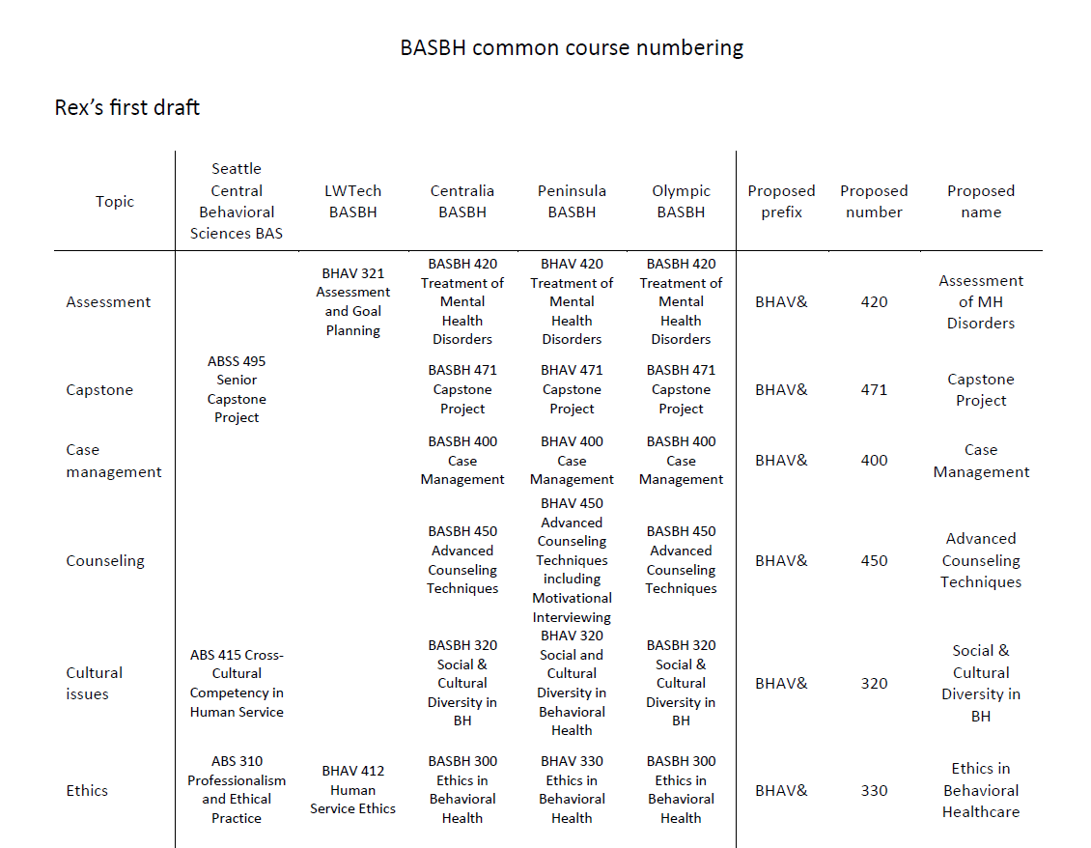

Slide 12
Decision making process
Faculty discussion
Sharing minutes/notes to all participants and interested parties
Discussions with our VPIs, seeking their agreement
Follow-up meetings to discuss course details and agree to CCN content

Slide 13
Adoption of BASBH common course numbering
Colleges may have to make changes to their catalogs to adopt CCN revisions
Colleges can optionally expand CCN-shared course names, add to shared course descriptions, and add to shared objectives
Did not require the adoption of a common core curriculum
Did not require a college’s adoption or teaching of any particular courses

Slide 14
How long did it take?
2019 2020 2021 2022 2023 2024 2025 2026
idea
drafting
discussions & decisions
curricular changes
SBCTC approval
relationship building
Internal approvals

Slide 15
Barriers
Interest
Trust
Course alignment
Competency agreement
Division of competencies across courses
Course credit count
Responsibility
Leadership
Work time
Follow-through

Slide 16
Barriers
BASBH
Interest
Trust
Course alignment
Competency agreement
Division of competencies across courses
Course credit count
Responsibility
Leadership
Work time
Follow-through
hx of collaboration
curricular match
few programs
self-directed
curricular match
self-directed

Slide 17
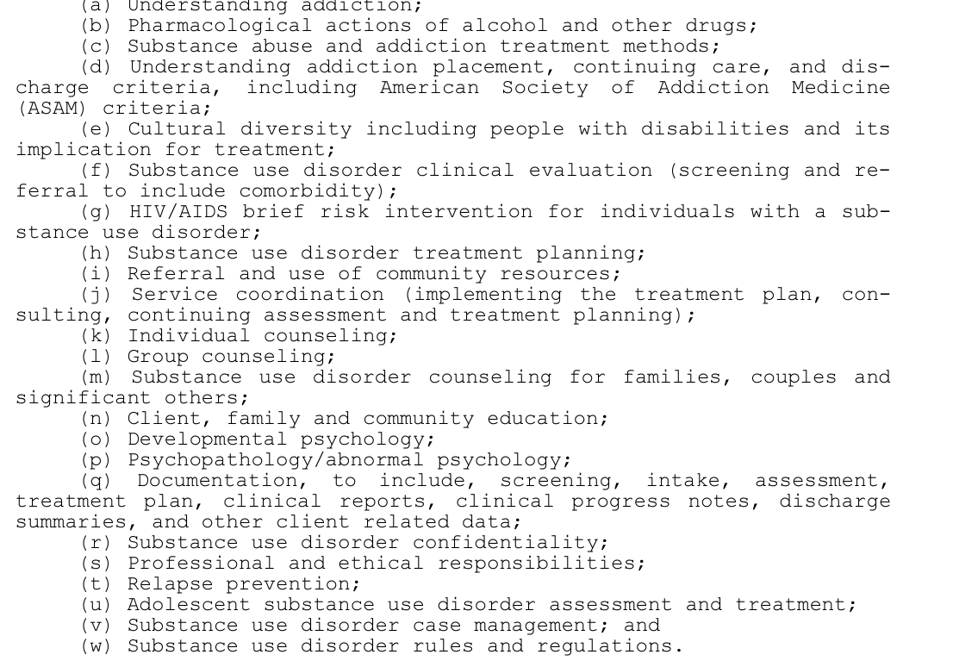
Substance Use Disorder studies

Slide 18
Possible SUD Studies CCN
2019 2020 2021 2022 2023 2024 2025 2026
relationship building
idea
idea
idea
discussions?
drafting?
Notes:
May not happen

Slide 19
SUD Studies CCN Barriers
significant interest
Interest
Trust
Course alignment
Competency agreement
Division of competencies across courses
Course credit count
Responsibility
Leadership
Work time
Follow-through
relationships
competency match
curricular mismatches
many programs
no volunteer
unfunded

Slide 20
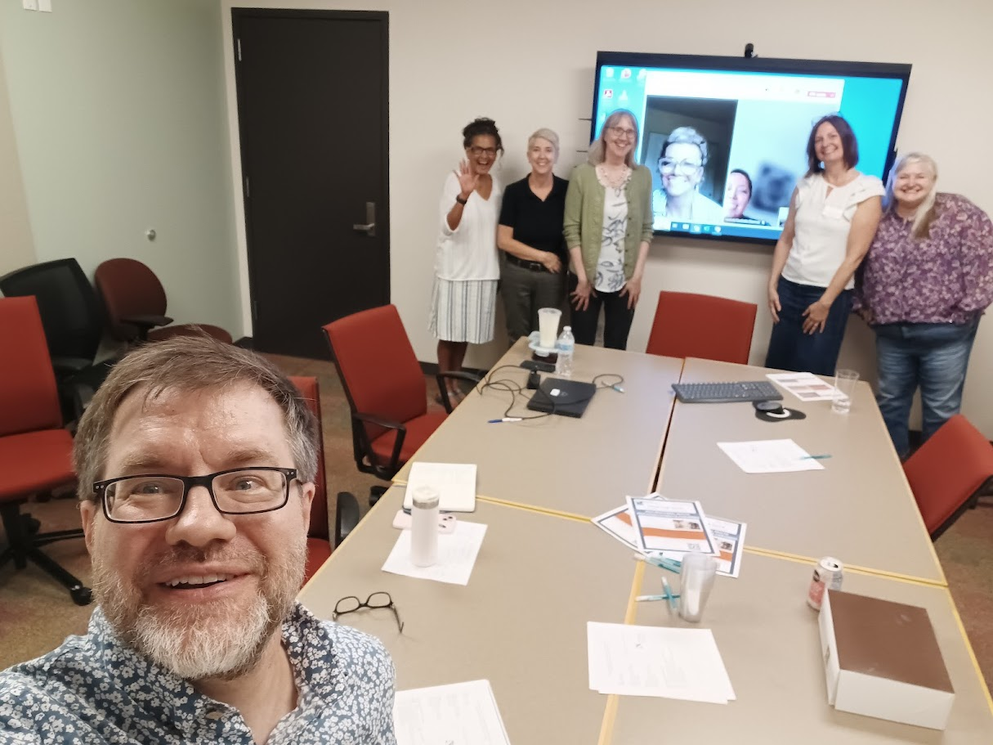
Suggestions
Start with relationship building
Provide practical aid to one another
Act when the field is small/new
Get a few schools on board
Have clear benefits
Follow a leader
Draft & discuss
Compromise
Stick with it
Expect slow implementation

