Slide 1
Liaison Report
Baccalaureate Leadership Council
Tuesday, April 16, 2024

Slide 3
The development of BAS Behavioral Healthcare Programs in Washington State
Rex Rempel, Wendi Nancarrow-Carter, Tim Malroy, & Dan Ferguson

Slide 4
2024 WASHINGTON BEHAVIORAL HEALTHCARE CONFERENCE June 13-14, 2024 Kennewick, WA SUPPORTING RECOVERY IN A CHANGING WORLD
Dan Ferguson, MS, WA State Allied Health Center of Excellence;
Tim Malroy, PhD, MS, Centralia College; Tanya Knight, PhD, Peninsula College
F507 BAS/Behavioral Health Programs in Washington State (1.5 CE clock hours)
Come learn about the applied baccalaureate in Behavioral Healthcare programs that community college leaders from across Washington have initiated to meet community workforce needs and assist students toward professional careers.
Liaison Report
Baccalaureate Leadership Council
Tuesday, April 16, 2024

Slide 5
Overnight Retreat for BAS/Teaching (BAS-TE) programs
The Center of Excellence for Careers in Education hosted the first face-to-face, overnight retreat for college BAS-TE programs, March 7-8, 2024, Tukwila.
Retreat purpose - Support BAS-TE programs in:
Obtaining full approval by the Professional Educator Standards Board
Dealing with the unique challenges faced by BAS-TE programs
Providing opportunities to network, share, and collaborate across programs.
Outcomes
The retreat was immensely successful, with representatives from 10 programs in attendance.
Participants expressed a desire for more frequent in-person events
Notable learning and valuable sharing occurred during both days of the retreat.
Monthly virtual meetings
The Center continues to host monthly virtual networking sessions for BAS-TE coordinators, which consistently receive high attendance.
These sessions are tailored to address the evolving needs, inquiries, and challenges of the programs and their respective colleges.
Questions: Jamie Wells, Director, jrwells@greenriver.edu.

Slide 6
Partners in Care Virtual Training Series (nwrpca.org)
https://web.nwrpca.org/events/Partners-in-Care-Virtual-Training-Series-1735173/details
Free
Registration

Slide 7
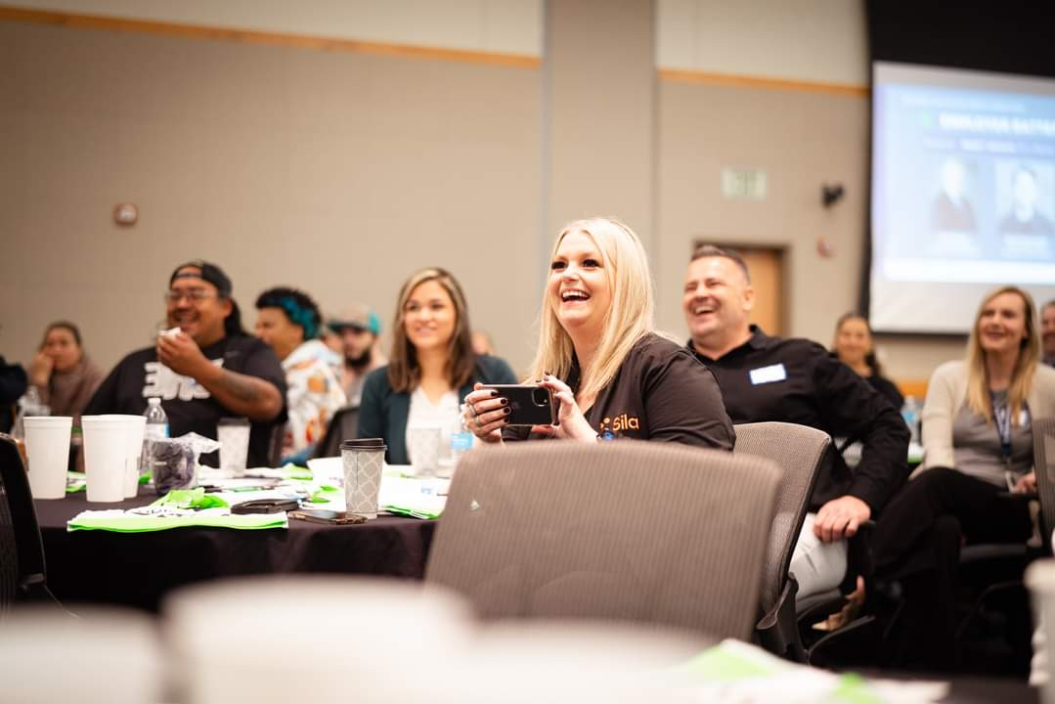
Building the Future Energy Workforce at Big Bend Community College, April 11, Moses Lake, WA
Nearly 150 attendees
Battery manufacturers: Group14 and Sila Nanotechnologies
Workforce panel: NCW Tech Alliance, Apple STEM Network, Employment Security Dept., SkillSource Regional Workforce Board, Dolumbia Basin Technical Skills Center and Big Bend CC
Legislative Chat: Rep. Vandana Slatter and Rep. Alex Ybarra
Coming up
Climate/Energy Fellows – Addressing the need for energy auditors for WA Clean Buildings Act with statewide Fellow placements.
Three summer STEM/Energy academies with hydrogen car experiments and energy career awareness.
EV technology training for CTC faculty.
PNWH2 Hydrogen Hub and H2 curriculum building/training

Slide 8
The Cybersecurity Center of Excellence (CCoE) of Washington State in collaboration with the National Cybersecurity Training and Education Center (NCyTE), and Whatcom Community College (WCC) presents the Securing the Next Generation of Technology Workers event.
Industry and academic representatives are invited to attend, network, and discuss cybersecurity workforce needs.
Register now for this unique opportunity to shape the future of the cybersecurity workforce in Washington State: https://ncytecenter.wildapricot.org/event-5517985

Slide 9
2024 Women in Leadership Symposium
Pierce College, Puyallup, WA
May 14-15, 2024
This year’s symposium will center around the importance of fostering robust and dynamic relationships and partnerships with women in Resilience Management and associated fields such as security, safety, emergency/risk management, and disaster preparedness.
Free to attend!
For more information: https://www.coehsem.com/women-in-leadership-symposium-2024/

Slide 10
The NEW Pathways to Excellence Program Guide in English and Spanish is now available!
This guide notes all of the Ag and Natural Resources programs in WA state, as well as listing BAS programs and transfer opportunities. This includes articulations between two-year and BAS programs, like WWCC to CBC for Applied Management, and CBC to WWCC for Agriculture Systems.
If anyone is interested, the guide can be found at https://agcenterofexcellence.com/program-guide/ , the COE is always happy to print hard copies.

