Slide 1
State Board for community and technical college
Spring Quarter Updates
Val Sundby, Director of Transfer Education
April 2024

Slide 2
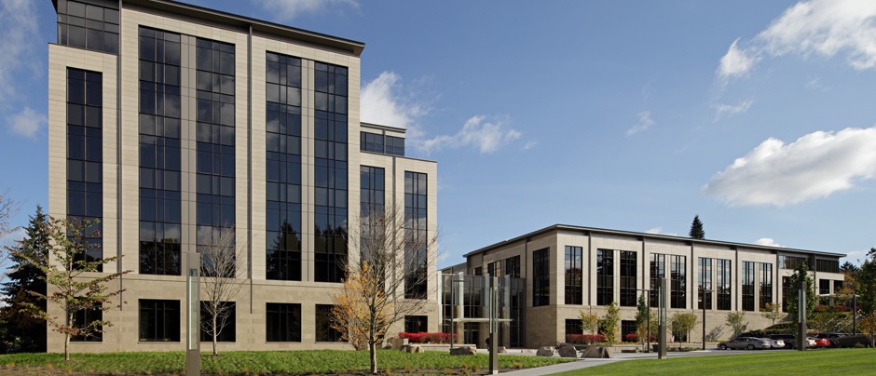
SBCTC is Moving!
Moving is underway. Education Division is moving today!
No cost to the colleges – move is funded by the legislature and part of their efforts to “right size” into state-owned, rather than leased, space.
Lots of great meeting space – we look forward to hosting system gatherings!
Capitol Campus - 1500 Jefferson Street SE, Olympia, WA 98501

Slide 3
2024 Legislative Session operating highlights
$1.14M ($9M proposed) for new Bachelor of Science in Computer Science degree programs
$475k ($950k proposed) for continuation of the curriculum development in Integrated Climate Solutions
$1.053M for FY24 expansion of College in the High School
$1.0M for Refugee Education expansion
$801k for Early Achievers Grant program support navigators
$425k for expansion of the financial aid outreach and completion initiative pilot program
$553k to fill the funding gap associated with the Postsecondary Student Needs (HB1559) benefits navigators

Slide 4
2024 Legislative Session capital highlights
$19,384,000 Bellingham Campus Center Repairs
$8,544,000 Statewide Utility Submeters
$478,000 ($724,000 requested) Statewide HB 1390 - Decarbonization Planning
$2,000,000 Statewide CTC Energy Efficiency Program

Slide 5
2024 Legislative Session policy items
SSB 5953 - Concerning financial aid grants for incarcerated students
SHB 1889 - Allowing person to receive professional licenses and certifications regardless of immigration or citizenship status
2SHB 2112 - Concerning opioid and fentanyl prevention education and awareness at institutions of higher education
2SHB 2214 - Permitting beneficiaries of public assistance programs to automatically qualify as income-eligible for the purpose of receiving the Washington College grant
SSB 5670 - Providing summer running start for rising juniors

Slide 6
2024 Legislative Session policy items
ESB 6296 - Establishing a retail industry workgroup
HB 1146 - Notifying high school students and their families about available dual credit programs and any available financial assistance
SHB 2019 - Establishing a Native American apprentice assistance program
SB 5904 - Extending the terms of eligibility for financial aid programs
HB 1943 - Modifying the Washington national guard postsecondary education grant program

Slide 7
2025 legislative session planning
Colleges are engaging via a survey distributed to presidents
Presidents are encouraged to gather input from their leadership teams, boards of trustees, faculty, staff, and students
Initial high priority areas:
Faculty and Staff compensation
Student services (mental health, basic needs, access to technology)
DEI funding and policies
Basic Education for Adults (IBEST, HS 21+)
Workforce education programs
College IT and Cybersecurity

Slide 8
Winter enrollment – sneak peak
Overall things are looking up!
Winter 2024 – up 11% overall (133,118 FTES) compared to Winter 2023
8% increase in state funded (88,550 FTES)
20% increase in contract-funded enrollments (42,951 FTES)
4% increase in self-funded enrollments (1,617 FTES)
Applied Baccalaureate – up 7% (317 FTES)
Basic Education for Adults – up 9% (1,156 FTES)
IBEST – up 23% (560 FTES)
Running Start – up 18% (3,836 FTES)

Slide 9
Enrollment trends

Slide 10
More Hot topics
Increase in ICAPP activity
Upcoming bachelor’s degree research
FAFSA Delay
Math Placement Grant
Course Sharing Software
Allocation Model Taskforce
Student Success Software RFP

Slide 11
Questions?
Val Sundby
Director of Transfer Education
vsundby@sbctc.edu

