Slide 1
Update on CCBA & the National Landscape for Community College Baccalaureate Degrees
November 17, 2021
Angela Kersenbrock, CCBA President
Debra Bragg, Bragg & Associates, Inc.

Slide 2
The Community College Baccalaureate Association
The only organization promoting better access to baccalaureate degrees on community college campuses, the CCBA serves as a resource for information on various models for accomplishing this purpose.
The CCBA is leading the national community college baccalaureate movement to ensure students in every community have direct access to high-value baccalaureate degrees as a means of closing the country’s racial, ethnic and economic gaps.
Notes:
ANGELA

Slide 3
CCBA’s Purpose
To increase the opportunity for underserved, adult, and non-traditional students to attain a baccalaureate degree in workforce occupations that offer economic security, career advancement, and upward mobility.
Notes:
ANGELA

Slide 4
“We believe in the power of the baccalaureate degree to change the lives of our students, their families and our communities.”
Notes:
The economic downturn in 2008-8, the WFH economy

Slide 5
CCBA Programs & Services
Professional development – annual conference and webinars
Strategies for working with state legislative groups
CCB program proposal development
CCB program & curriculum development
CCB best practices scale-up
CCB accountability plans
Partnerships w/universities for discounted tuition for faculty and graduates
Notes:
ANGELA

Slide 6
National CCB Program Inventory

Slide 7
Methods
IPEDS/Carnegie Basic Classification - March & October 2021
State agency and institutional follow-up
Legislative analysis
Institutional website analysis
Cross-team validation

Slide 8
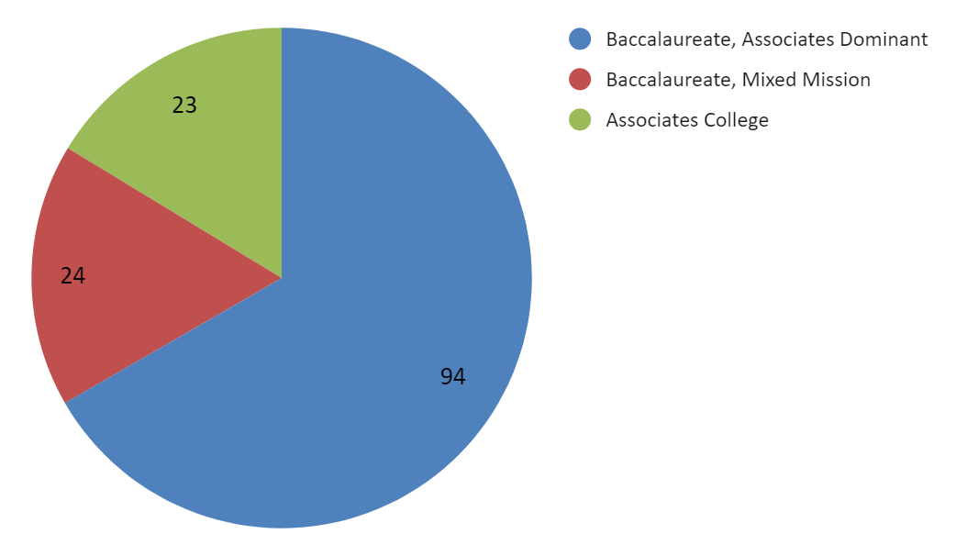
CCB Institutions by Carnegie Classification

Slide 9
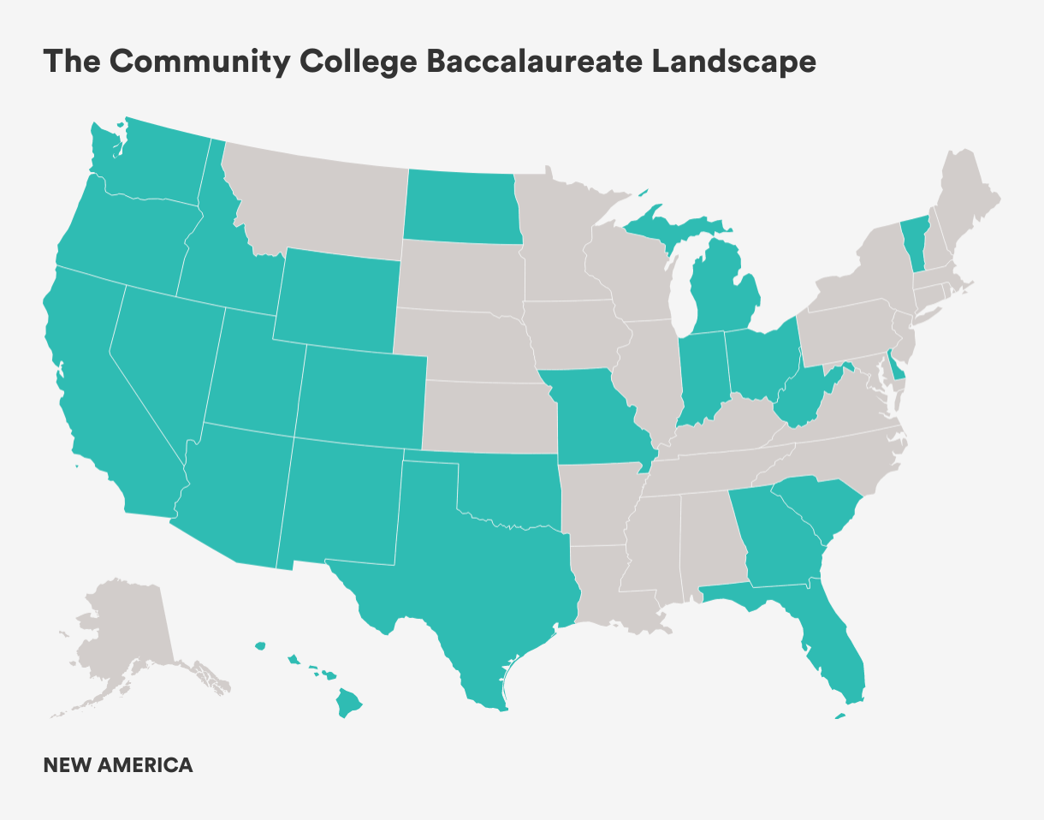

Slide 10
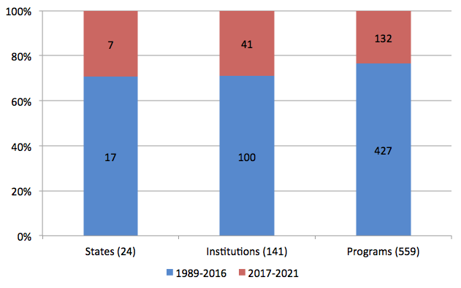
Implementation in Last 5 Years

Slide 11
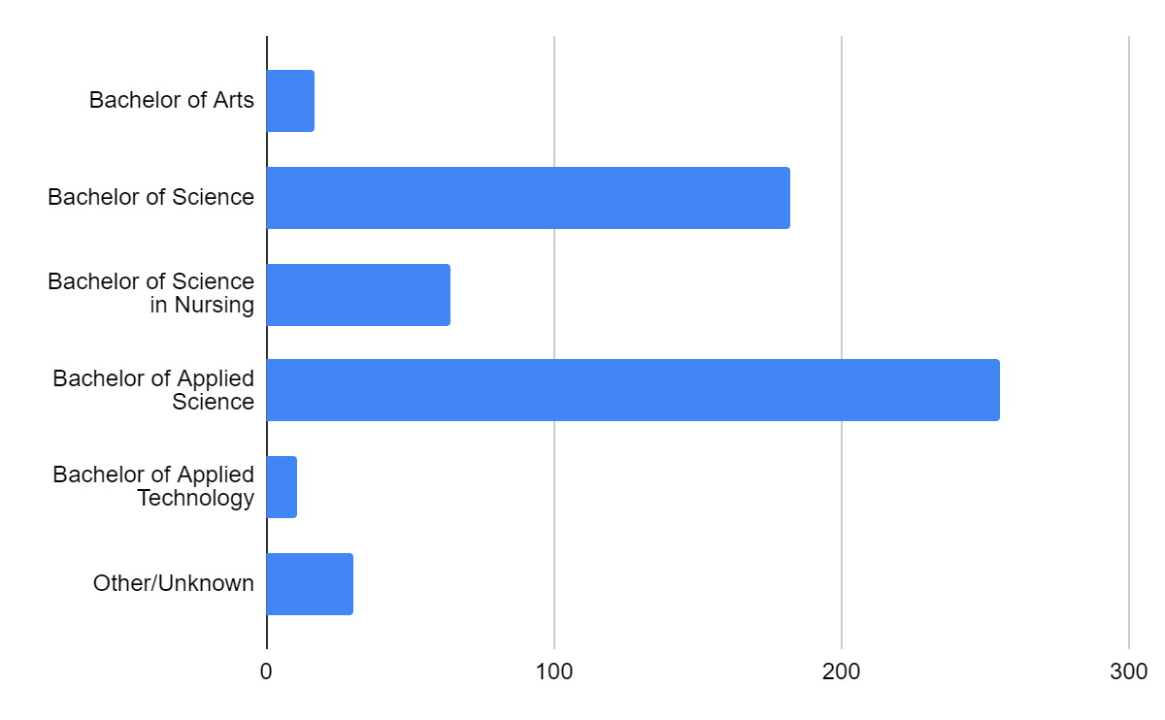
CCB Programs by Type of Degree

Slide 12
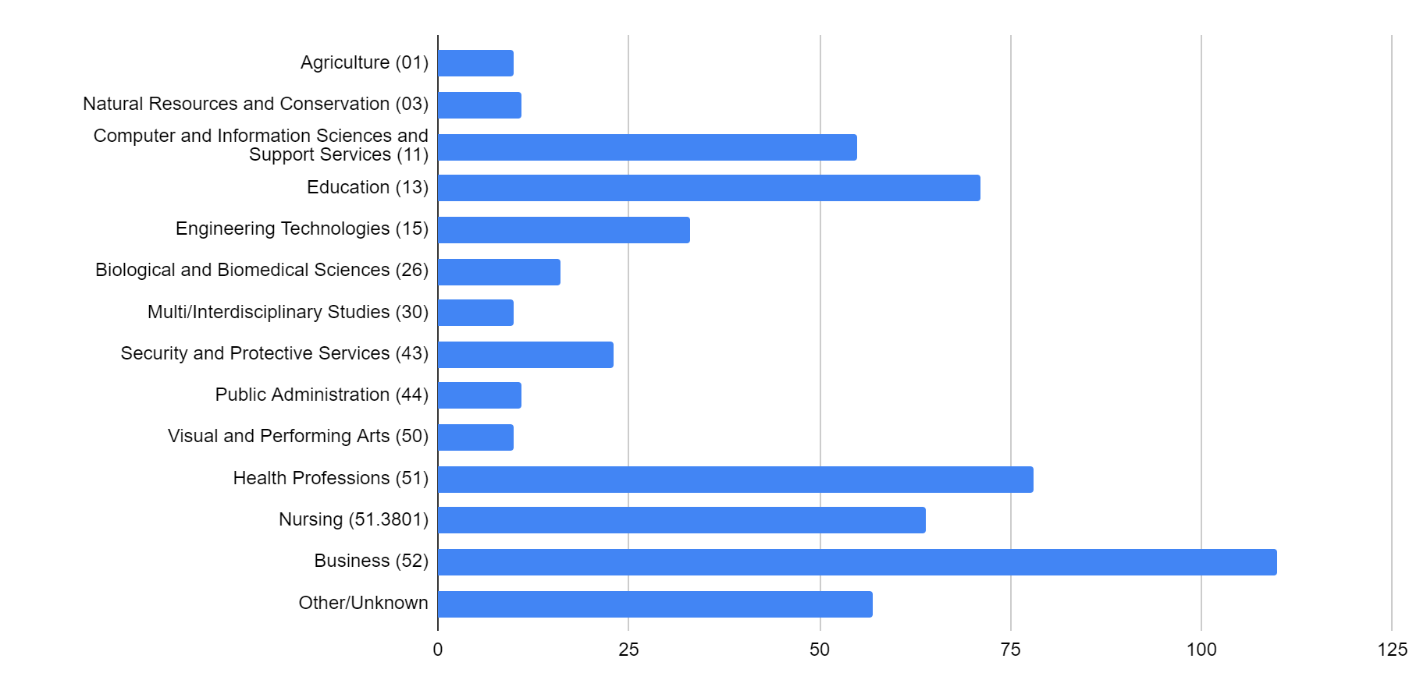
CCB Programs by CIP Code

Slide 13
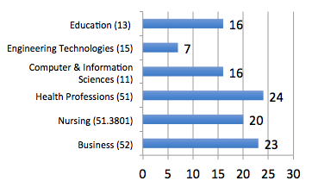
New CCB Programs in Last Five Years

Slide 14
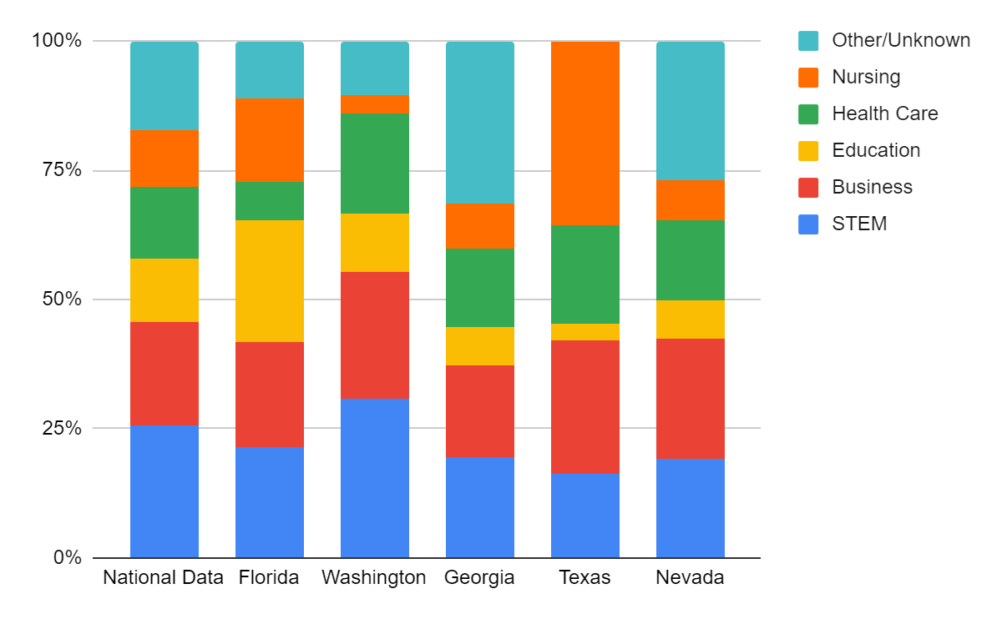
CCB Programs in High-conferring States

Slide 15
CCB Promising Practices Project

Slide 16
CCBA/ECMC Project Goals
2. Identify & share promising practices in high-quality CCB degree programs
3. Disseminate & promote CCB degrees to help scale-up high-quality programs and practices
1. Inventory all CCB-conferring states, institutions and degree programs in the United States

Slide 17
Promising Practices Project Activities:
Form a national advisory panel to help identify and describe promising practices
Advisory panel suggest data collection methods to identify promising practices (i.e., online surveys, websites, interviews and other strategies)
Advisory panel nominate and recommend promising practices of greatest interest and need to the evolving CCB field
Advisory panel recommend dissemination, publication and other strategies to promote promising practices

Slide 18
Promising Practices are…
key to making innovative, workforce-focused CCB programs succeed. They are critical ingredients to high-quality CCB programs that produce equitable education, employment, and life outcomes for students and graduates. Promising practices demonstrate what works in a real-world setting; they may be rooted in practical experience and also in evidence such as qualitative and quantitative data gathered by program faculty and staff.
Examples of promising practices are wide ranging and may include recruitment of underserved students, cohort models, online or hybrid delivery, retention specialists/navigators, total ~$10,000 tuition, and employer tuition reimbursement and hiring commitments.
Many more promising practices exist, and it is our goal to find them, document them, and share them nationwide.

Slide 19
Promising Practices Nominated by Advisory Panel
Fully transfer 60 credits of associates degree to ensure students need only 60 credits to complete the BAS
Partnering students with industry mentors – “last mile” intervention that included the career search process
Paid industry capstone project that enables students to document work experience on resumes and may also lead students to secure internships and employment
Competency-based education (CBE), extended apprenticeships, and prior learning assessment (PLA) that are linked and may involve other practices

Slide 20
Promising Practices (cont.)
“Credentials of value” to industry and professional associations specially designated to CCB programs
Capstone programs to the BAS
Capstone tour/event with graduate schools to expose graduating students to this option
BAS program development aligning non-credit and credit
Associates-degree students receive automatic admission notice to the related BS/BAS program (e.g., ADN to RN/BSN)

Slide 21
Promising Practices (cont.)
360 equity from entry requirement to instruction
CCB Navigator to keep students on track and progressing to bachelor’s degree completion
Peer mentors (upper classman/woman who help with orientation) and faculty advisors who are faculty within the program who keep students on track to complete program requirements)
$10,000 degree tuition

Slide 22
Link to Nominate CCB Promising Practices
https://www.surveymonkey.com/r/CCB-Practice-Nomination
Thank you!

Slide 23
Upcoming CCBA Webinars
January 20, 2022 – Scaling Up CCB Degrees in California
March 24, 2022 – Why & How CCBs Work from Students & Graduates
April 21, 2022 – Employer Partnerships Integral to High-Quality CCB Programs
June 9, 2022 – Key Ingredients to Equity-Centered CCB-Degree Programs
All webinars are scheduled at 2pm Eastern. Check the CCBA website and monthly newsletters for more details as the dates approach.
CCBA Website: https://www.accbd.org/
CCBA Twitter: @CCBA_Network

Slide 24
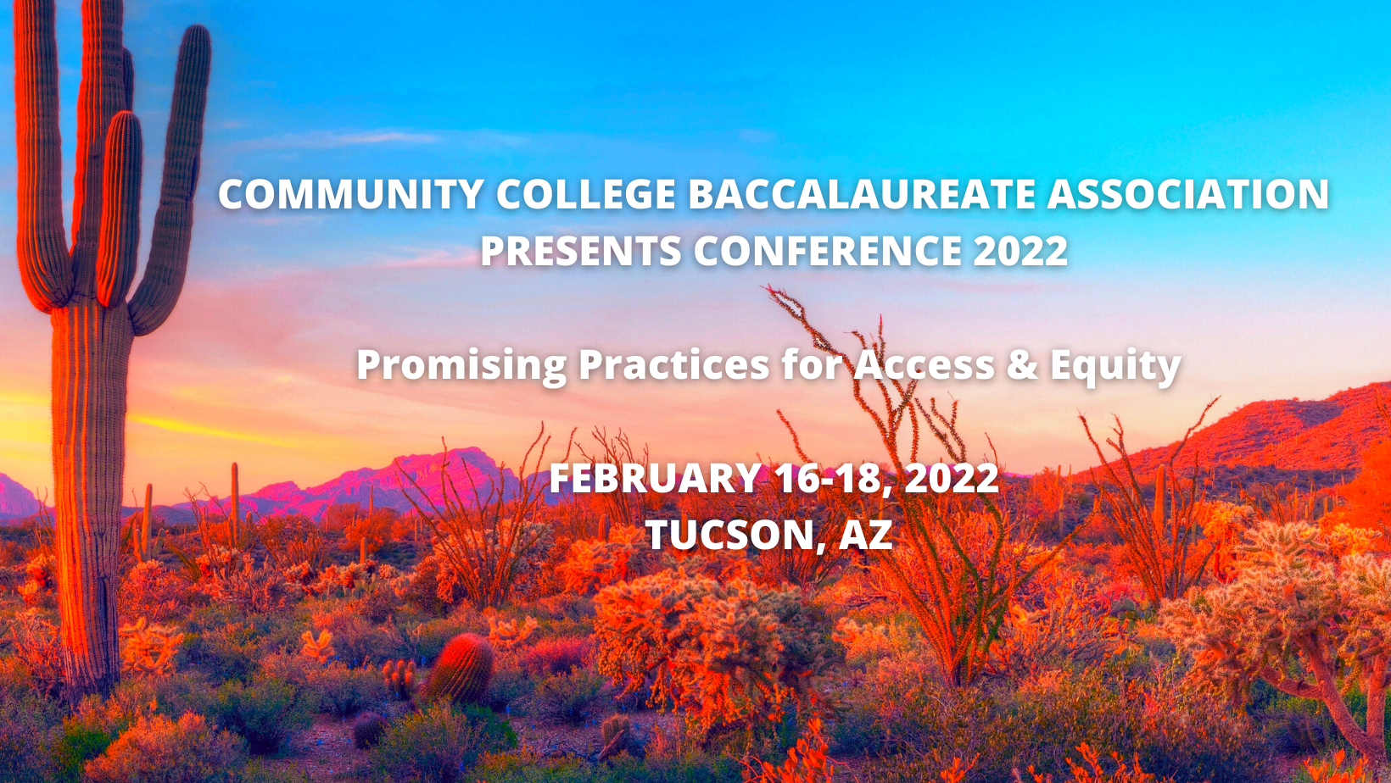
Notes:
ANGELA

Slide 25
Seeking Student Scholars 2022 CCBA Student Scholarship Program Taking Applications
Current CCB students and graduates of active CCBA Institutional Member colleges are invited to apply now through December 17. Awards will be presented during Conference 2022 in Tucson, AZ (attendance is encouraged, but not required).
To apply, go to:
https://docs.google.com/forms/d/e/1FAIpQLSck65x0yf0uzXp4VN3EL_D4qDsdkwdO59xxfJQN-TVxNEbHvQ/viewform

Slide 26
Contact Information
Angela Kersenbrock, President
Community College Baccalaureate Association
Email: akersenbrock@ccbad.org
Website: https://www.accbd.org/
Twitter: @CCBA_Network
Debra Bragg, President
Bragg & Associates, Inc.
Email: Bragg.Associates.Inc@gmail.com
Phone: 217-377-3100
Twitter: @ddbragg and @BraggAssociates

