Slide 1
2019 BLC Winter MEETING SBCTC REPORT
Jamilyn Penn Director of Transfer Education - SBCTC
January 25-26, 2021
Zoom-Virtual Meeting

Slide 2
COVID Update
Governor Inslee sets goal of 45,000 COVID-19 vaccinations a day in Washington State
The process includes Phases 1B1-1B4 (or Phases 1-4)
Currently K-12 teachers and school staff will be eligible to receive the vaccination during Phase 1B2 (Tier 2)
Currently no changes as when higher education faculty and college staff will be eligible. Jan Yoshiwara, Executive Director at SBCTC has this issue on her radar

Slide 3
Bas Proposal Process
Old BAS Proposal Process:
Idea Stage
Thinking about BAS program
Notice of Intent
Send notification; 2-page document to SBCTC
Posted to ICAAP Grid
Degree Proposal
Statement of Need
30-day review
Waiting for External Review
Completed 30-day review
Wait for final approval from SBCTC Board of Trustees prior to program implementation
New BAS Proposal Process:
Idea Stage
Report to SBCTC
Not posted to ICAAP grid
Degree Proposal Stage
Prepare Statement of Need
Posted to ICAAP grid
30-day review
Waiting for External Review Stage
Completed 30-day review process
Develop BAS
Wait for final approval from SBCTC Board of Trustees prior to program implementation

Slide 4
BAS Proposal Process-Report to the Grid
Moving from reporting to the ICAAP grid 12 times per year to 6 times per year (January, March, May, July, August, and November)
Encourage communication between colleges, two-year and four-year, alike
Promote on-going technical assistance with SBCTC
FAQ for ICAAP Program Planning coming soon

Slide 5
BAS Certification Policy
Modifications to the BAS Certification
Requirements to BAS certs that are greater to 20 credits
Primary change is related to Coding (both Legacy and ctcLink)
New policy will be posted by end of month

Slide 6
BAS Data
BAS student headcount increased in all race and ethnicity categories with the largest percentage increase being Hispanic/Latino at 36 percent (577 in fall 2019-20 to 785 in fall 2020-21). Given the overall declines and concerns about historically underserved students, this is a positive and encouraging pattern to see.

Slide 7
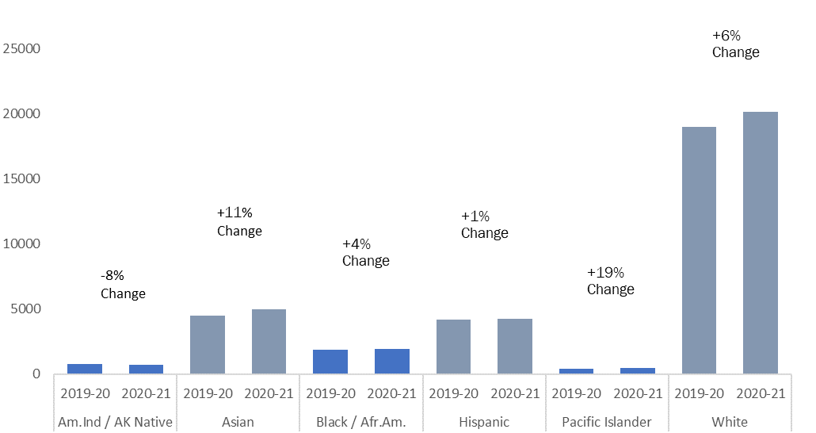

Slide 8
BAS Data Dashboard
Summer Kenesson is working of developing BAS-specific data dashboards
Would like to know what type of data would be beneficial for colleges; what would colleges like to know data-wise about BAS programs
Survey will be distributed to get feedback (distributed to BLC, ATC, and WEC). Look for survey in your inboxes by February 1, 2021.

Slide 9
Guided Pathways
Initiative in Diversity, Equity, and Anti-racism Leadership (IDEAL) Fellowship-Application released in December and closed January 15-558 applications received. College Spark will help to support 35 students in the 2021 cohort.
GP Coaching-Initial meetings with colleges are nearly complete. College leaders have connected with assigned coach team and have started plans for the coming academic year. Spring virtual site visits scheduling is underway. Coaches continue to receive professional development, including an upcoming Coaching for Equity training in spring.
GP Work Plan 2.0-Templates will be released no later than March 15, 2021, and will be due May 15, 2021.

Slide 10
LPN-to-BSN Update
Moving towards development of a LPN-BSN DTA
Would like a program model with 180 credits or less
Nursing educators are considering essential coursework and credits in both lower and upper division courses
Recent meeting with LPN program directors to see what the credit limit could be (ex. Bellingham has an PN program with 38 credits), so that graduates are deemed educated (or safe) enough to work in industry
Follow up meeting with faculty coming soon

Slide 11
Undergraduate Research
Consortium for Undergraduate Research & Equity (CURE): Advancing Systemic Change at Washington Community Colleges to Provide Equitable and Sustainable Institutionalization of Undergraduate Research
NSF Grant-Due February 2, 2011
Lead College, Bellevue College with Dr. Gita Bangera as the Principal Investigator
All hands on deck-Colleges, administrators, faculty, students, SBCTC

Slide 12
Amazon Bill
Bill request authorizing community and technical colleges to offer Bachelor degrees in Computer Science
If passed, the approval process will be the same as the current BAS Proposal process, with authority to implement granted by SBCTC Board
Council of Presidents (COP), four year public higher education partners, will not weigh in on this request. However, we may expect pushback from several four-year institutions.

Slide 13
Legislative Session
In 2021, the Washington State Legislature is scheduled to convene on January 11 and adjourn on April 25.
The session is 105 days (odd years); 60 days (even years)
SBCTC is focused on protecting interests related to HB 2158-Guided Pathways; Access, and Equity
Bill Status Report: January 21, 2021 shared for BLC minutes, but remember things change from one-minute to the next

Slide 14
Equity
DEI work at SBCTC
Affinity Groups
Several book studies
Conversations related to hiring practices
Legislative update:
HB 5227 Diversity, etc. in high education (Sponsor: Senator Randall)
HB 1016: Juneteenth (Senator Morgan)

Slide 15
2021 Legislative interns
SBCTC is excited to welcome two Legislative Session Interns during the 2021 Legislative Session. They will be working virtually with the SBCTC Legislative Director and other staff in support of our system’s legislative priorities and goals:
Da’Mea Birdsong Junior at Whatcom Community College, majoring in Political Science (DTA)
Sydney Sharp Skagit Valley College. Pursuing a dual major in Physics and Bioengineering

Slide 16
QUESTIONS
Please contact: Jamilyn Penn Director of Transfer Education jpenn@sbctc.edu 253-302-9395 Thank you!

