Slide 1
Jamilyn Penn, Director, Transfer Education-SBCTC
2019 ICRC FALL MEETING
SBCTC REPORT
October 10-11, 2019
Western Washington University

Slide 2
Jamilyn’s Educational FootPrint

Slide 3
SBCTC State Board’s Strategic Priorities
Equity focused/equity lens
Guide Pathways and other proven student success strategies
Implement Strategic Enrollment plan
Implement Career Connect Washington
Advocacy and Community engagement

Slide 4
Equity and Diversity Resolution 19-06-28
SBCTC Vision Statement-
Leading with racial equity, our colleges maximize student potential and transform lives within a culture of belonging that advances racial, social and economic justice in service to our diverse communities.

Slide 5
College facts
Notes:
Type of student is for the 2017-18 academic year
Race/ethnicity is for the 2017-18 academic year
*total may not add to 100% because students may be counted in more than one race
45 percent of community and technical college students are students of color

Slide 6
Community and technical college facts
362,862 students enrolled
50% full-time
56% women
58% of students enrolled in Washington’s public higher education system are enrolled in community and technical colleges.
Notes:
Bullets 1-3 are for the 2018-19 academic year
Bullet 4 is from the Office of Financial Management’s 2015-16 Budget Driver Report. Includes state-supported and Running Start students.

Slide 7
COLLEGE TRANSFERS 2016-2017
Public BI’s 10,572
Western Governors University 2,373
Independent Colleges of Washington 1,593
CTC’s BAS Programs 1,447
Other independent colleges 394
Portland State University 142
After College Status: Transfers
Notes:
Should have data by December through 2017-2018. U of Phoenix dropped 1504 students to 314 past five years

Slide 8
College Transfers 2016-2017**
Transfers to Independent and Other Baccalaureate Institutions:
https://www.sbctc.edu/colleges-staff/research/data-public/transfers-dashboard.aspx
**The data for 2017-2018 will be available in December 2019, or later

Slide 9
2017-18 transfer degrees awarded
Direct Transfer Agreement (DTA) 15,578 Business DTA/MRP 1,883
AS-T Track 2 (Engineering/Physics) 895
Pre-Nursing DTA/MRP 571
AS-T Track 1 (Biology/Chemistry) 397
Nursing DTA/MRP 288
Biology DTA/MRP 246
Credentials Awarded Dashboard
Notes:
2018-19 Transfer data available late-fall 2019

Slide 10
Career Connect Washington
Partnering with the Governor's Task Force
K-12-Baccalurate pathways
Identifying actionable and effective steps to promote educational pathways
Focus on careers for Washingtonians

Slide 11
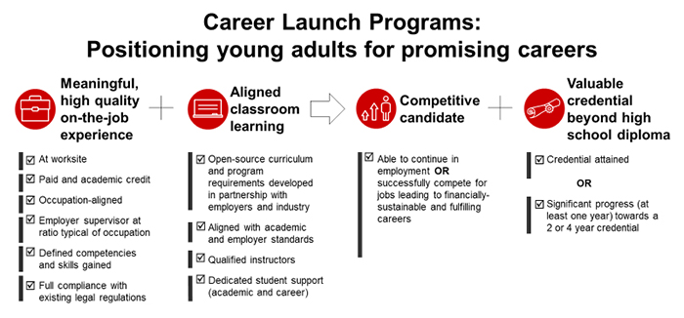

Slide 12
Transcript Posting Requirements
Locally designed associate degrees also intended for transfer by an individual college may not carry the DTA, AS-T, or DTA/MRP titles
Unless approved by SBCTC degree approval process and registered on the transfer degree inventory (last updated July 31, 2019)
Negotiated Agreement
Between SBCTC (representing 32 community and technical colleges) and the public and private four-year baccalaureate institutions

Slide 13
AP/IB/CI Crosswalks
AP Scores Crosswalk 2019 published/posted
IB Scores Crosswalk 2019 reviewed and approved by Instructional Council (IC)
Cambridge Scores Crosswalk 2019, still under discussion

Slide 14
Hot Topics
System-Wide Credit Policy for AP/BI/CI
Guided Pathways
Reverse Articulation
BAS Programs
Career Launch
Nursing (funds and pathways)
Notes:
Advanced Placement Crosswalk finalized and distributed to meet July 31 effective date. ESSB 5410. Work continues on IB Crosswalk
Guided Pathways work underway--E2SHB 2158 brings $30 m in FY 21!
Reverse Articulation- still figuring out ways to increase student participation.
BAS programs now top 100 system wide.
Career Launch Endorsement Review, also E2SHB 2158 adds funds for FTES and equipment.

Slide 15
CtclINK (PeopleSoft/Product)
Tacoma Community College and Spokane Colleges up and running
Clark College and SBCTC transitioning
Launch Monday, October 28, 2019
Alignment and continued movement/support
This Photo by Unknown Author is licensed under CC BY-NC-ND

Slide 16
ICRC Membership List Updated
Thank you, Lori Crist-SBCTC Secretary Senior, Education Division

Slide 17
Questions
Please let me know if you have questions.
I look forward to working with you.
Contact Info.:
jpenn@sbctc.edu
360-704-4338

