Slide 1
Applied Baccalaureate Approval Process
Dr. Joyce Hammer, Director of Transfer Education, SBCTC
Mike Potter, Dean of Instruction, LWTech
2018 Annual Applied baccalaureate conference, November 14th
Notes:
The Buck Stops Here! State Leadership in Implementing and Scaling AB degrees
What role do state agencies play in baccalaureate degree implementation and sustainability? What criteria do states use to approve and fund baccalaureate degrees, initially and over time? What role do accrediting bodies play in implementation and sustainability? This session considers the role that state agencies and accrediting bodies play in the local implementation and sustainability of baccalaureate degrees.

Slide 2
History
2005 pilot (Bellevue, Olympic, Peninsula, South Seattle), 2010 regular status
2012 SBCTC authorized to approve
2018-2019: 98 programs at 29 colleges
2017-2018: 3142 FTEs enrolled, 3960 headcount, 888 Completions (3333 total through summer 2018)
Enrollments are 1.8% of total enrollments in college system

Slide 3
WA Applied Baccalaureate Degrees
  Often called BAS/BSN
  Builds off of professional/technical associates degree (e.g. AAS-T)
  180 credits
    Minimum 60 qtr. credits general education
    120 credits applied/core courses
    Includes upper/lower division courses (60 qtr. credits)
  Regional university tuition rate

Slide 4
Earning Potential & Mobility
Technical ≠ Terminal
State Goals
Close Skills Gaps
Diverse Workforce Students
WHY BAS DEGREES?
Notes:
Pathways!
Increase education pathways for diverse workforce student population
Ensure technical degrees not terminal
Meet state goals for baccalaureate degrees awarded
Expand workforce mission of CTCs by closing skills gap for local employers/economies
Increase earning potential and social economic mobility
Increase education pathways for diverse workforce student population
Ensure technical degrees not terminal
Meet state goals for baccalaureate degrees awarded
Expand workforce mission of CTCs by closing skills gap for local employers/economies
Increase earning potential and social economic mobility

Slide 5
Program trends
Applied Management
Information Technology (e.g. networking admin. systems software, application development)**
Nursing
Dental Hygiene
Funeral Science Education
Health professions (e.g. health infomatics and management
Cyber Security
Teacher Education/Early Childhood Education
Natural Resource and Sustainability
Notes:
**Names are standardized!

Slide 6
Stakeholders
SBCTC
External education
Internal
Outside
Legislature
Presidents
NWCCU
VPIs
Council of Presidents
Department of Education
Workforce
Independent Colleges
Business and Industry
BAS Directors
Notes:
WA Roundtable, Association of WA Business

Slide 7
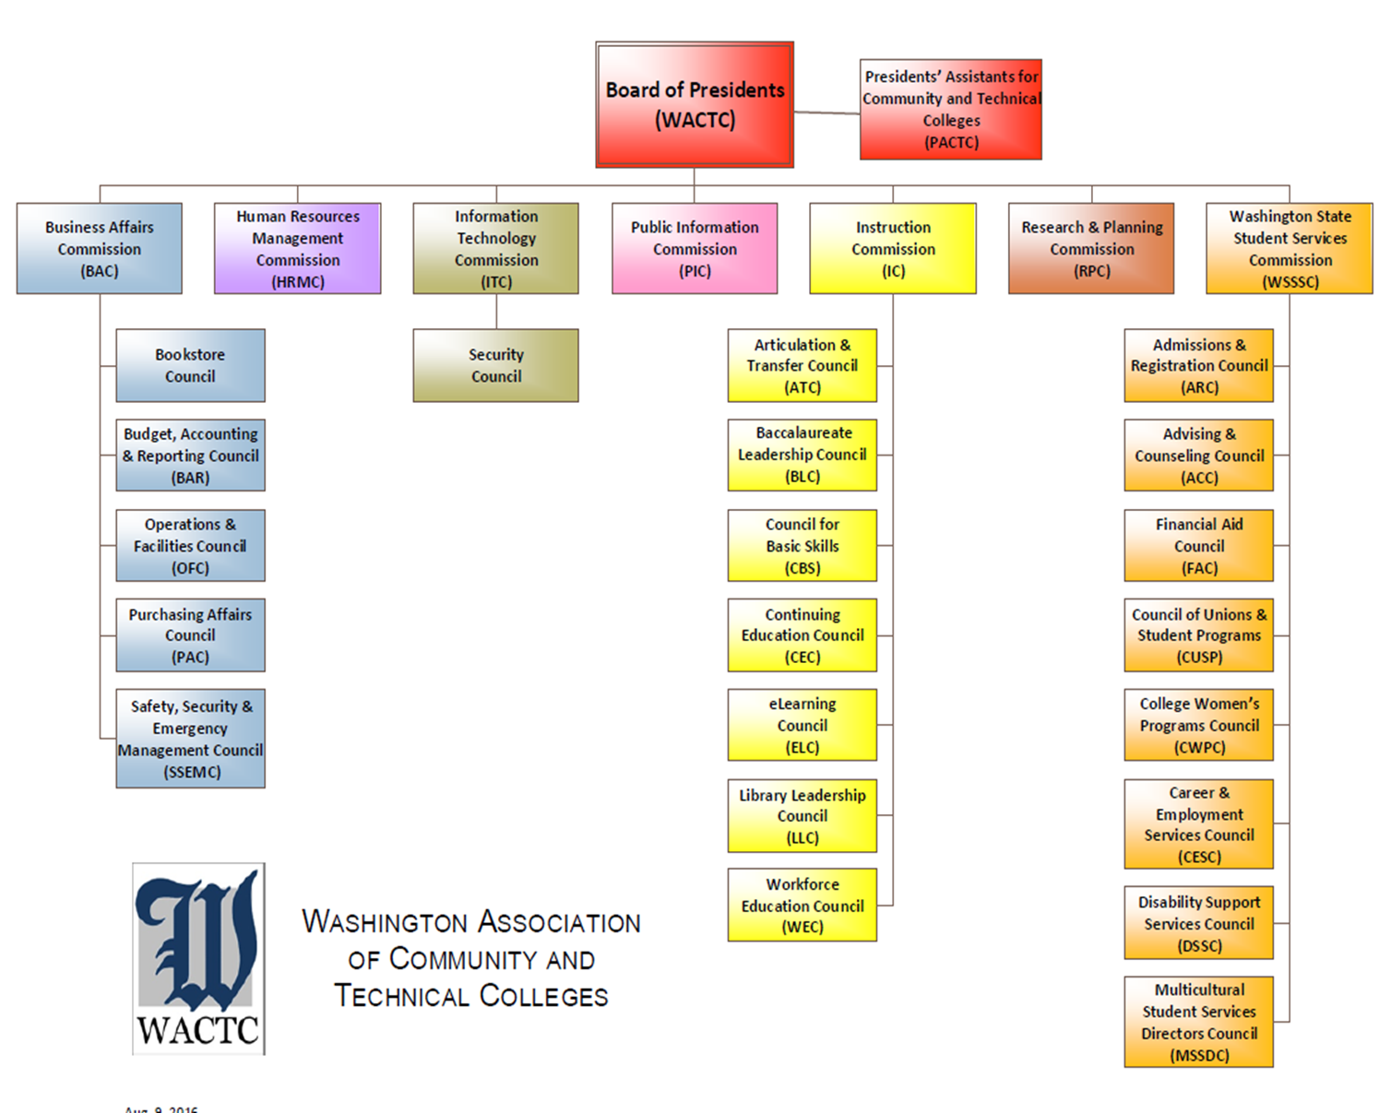

Slide 8
Applied Baccalaureate Timeline
Statement of Intent
Board Study Session
Peer Review
30 Day Review
1. College informs SBCTC of intent
2. SBCTC staff informs higher education community
of intent through ICAPP grid
3.College develops Statement of Need
4.College contacts impacted BIs
1. SBCTC staff informs all two-year, four-year, higher education institutions of new program for public comment
2. SBCTC staff reviews Statement
of Need based on approval criteria adopted by State Board
Statement
of Need is
discussed by
State Board in
study session
(not an approval).
2. College responds to any BI concerns
3. College develops
Program Proposal
1. SBCTC staff in collaboration with Commissions and BLC reviews Program Proposal
2. Peer Review
of Program Proposal for colleges new to accredited BAS degrees
Notes:
Length of time over one year. We recommend 18 months.

Slide 9
Applied Baccalaureate Timeline
Accreditation
Board Approval
DOE/ Financial Aid
1. Program proposal is scheduled with State Board
for approval
2. If approved…
1. College moves program to NWCCU for Accreditation
2. College submits application for Veterans Services approval
3. Nursing Commission (if applicable)
1. College moves program to Department of Education for Financial Aid approval
2. Program Implementation
Notes:
Length of time- can be over a year. We recommend 18 months.

Slide 10
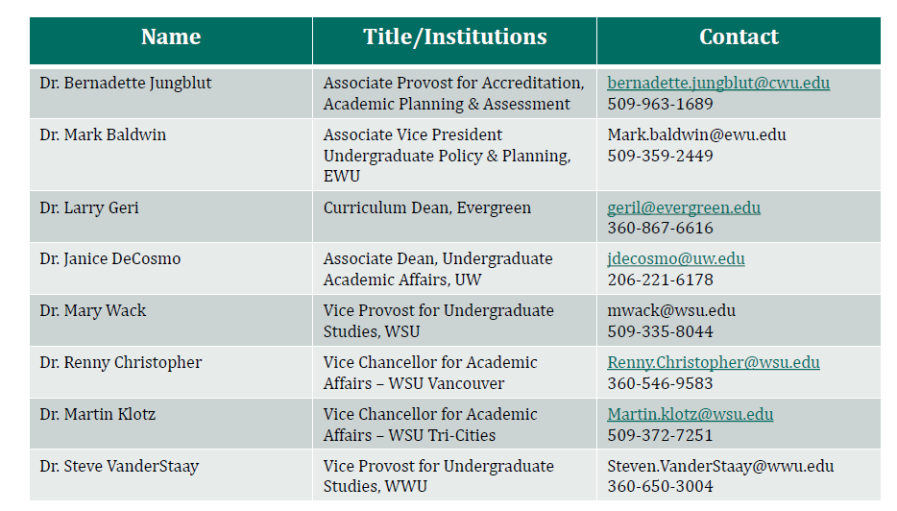
Public BI Contacts

Slide 11
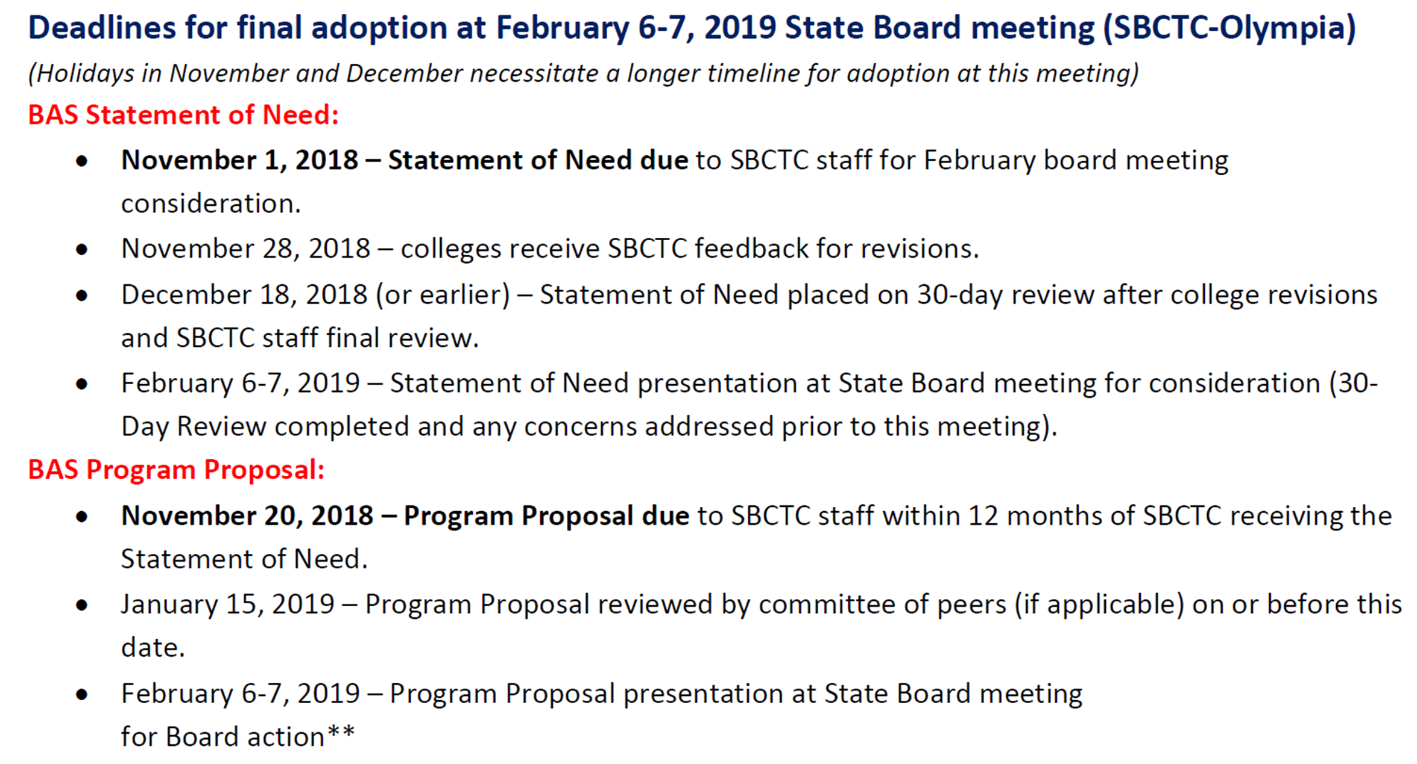

Slide 12
May 1-2, 2019 State Board Meeting
BAS Statement of Need:
February 11, 2019– Statement of Need due to SBCTC.
March 27, 2019 (or earlier) – Statement of Need placed on 30-day review after college revisions.
BAS Program Proposal:
February 20, 2019 – Program Proposal due to SBCTC staff within 12* months of SBCTC receiving the Statement of Need.

Slide 13
Website
Applied Bachelor Program Approval Process

Slide 14
Statement of Need Criteria- Phase I
Institutional role, mission, program priorities
Statewide strategic plan
Employer/local demand/ higher wage jobs
Existing professional and technical degree program
Student demand/place-bound factors
Conversations with universities/brief program outcomes
Notes:
Employers demand the level of technical training proposed
Leads to high wage-earning jobs
Fills a gap in options available for students because it is not offered by a public four-year institution of higher education in the college's geographic area.
Supply/demand gap
Provide demand information from:
at least 25 individual employer responses or;
employers who comprise at least 75% of the identified employment base.
Accreditation requirements

Slide 15
Criteria 3
Supply/Demand Gap Rubric (REQUIRED!)
Employer Survey (emerging fields)
  at least 25 individual employer responses or;
  employers who comprise at least 75% of the identified employment base.
  Required questions
Accreditation Requirements
Notes:
Get Jon Lederer slides form CCBA 2016
Include criteria 3 rubric

Slide 16
Tools to Identify Supply/Demand
SBCTC Centers of Excellence
Economic Modeling Specialists Intl.
Employment Security Department-WA State
  Monthly Employment Report
  Local area demand/decline occupations
  Employer demand reports
Burning Glass
  Moving the Goalposts: How Demand for a Bachelor’s Degree Is Reshaping the Workforce
National Center for Higher Education Management Systems (NCHEMS)

Slide 17
Proposal Criteria- Phase II
Curriculum rigor
Qualified faculty
Admissions process
Student Services
Financial commitment
Accreditation
Pathway options beyond applied baccalaureate
External reviewers

Slide 18
Proposal Best practices
Library Rubric
Admission GPA (2.5)
Student Services
Assessment Tables
Course Tables (with 180 credit total)
Faculty Tables
Tables, Tables, Tables

Slide 19
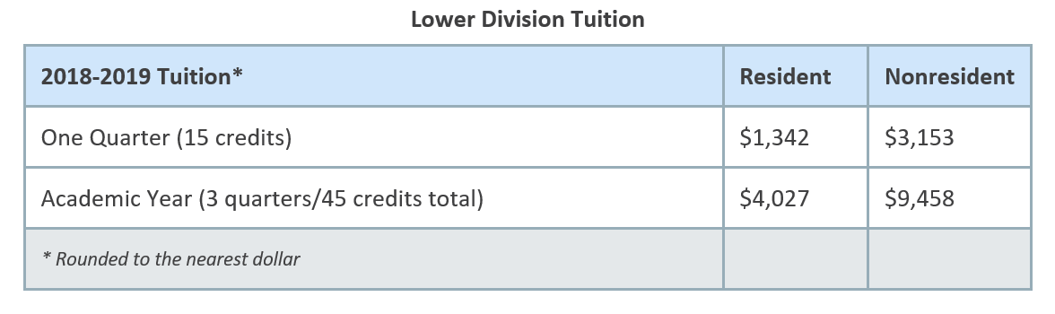
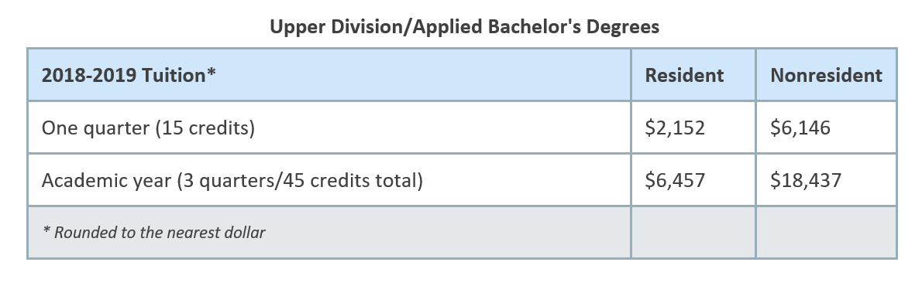
Tuition and fees
Notes:
UPDATE

Slide 20
 | First Applied Baccalaureate Degree | Projected Expenses
Expense |  | Year 0-2015/2016 |  | Year 1 -2016/2017 | Year 2 – 2017/2018
FT Faculty (Instruction - 1.0 FTE after Year 1) |  | $ - |  | $ 20,460 | $ 62,000
PT Faculty (Instruction - .66 FTE after Year 1) |  | $ - |  | $ 4,303 | $ 23,839
Curriculum/ Program Development |  | $20,000 |  | $ 30,000 | $ 10,000
BAS Program Manager (1FTE) |  |  |  | $ 28,000 | $ 56,000
Librarian (.25 FTE) |  |  |  | $ 15,500 | $ 15,500
Financial Aid (.25 FTE) |  |  |  | $ 5,000 | $ 10,000
Credentials (.25) |  |  |  | $ 5,000 | $ 10,000
Clinical/Practicum coordinator (.5FTE) |  |  |  | $ - | $ 22,000
Total personnel |  |  |  | $108,263 | $209,339
Benefits (35%) |  |  |  | $ 37,892 | $ 73,269
 |  |  |  | $146,155 | $282,608
Library Resources |  | $ - |  | $ 30,000 | $ 20,000
Goods and Services |  |  |  | $ 5,000 | $ 4,000
Marketing and Outreach |  |  |  | $ 5,000 | $ 3,000
Equipment purchases and replacement (1 lab) |  |  |  | $ 30,000 | $ -
Professional Development, Research, and Travel |  |  |  | $ 10,000 | $ 10,000
Projected Expenses |  |  |  | $226,115 | $319,608
Notes:
Projected Expenses
$ 226,115
$319,608
$ 315,931
$356,247
$332,811

Slide 21
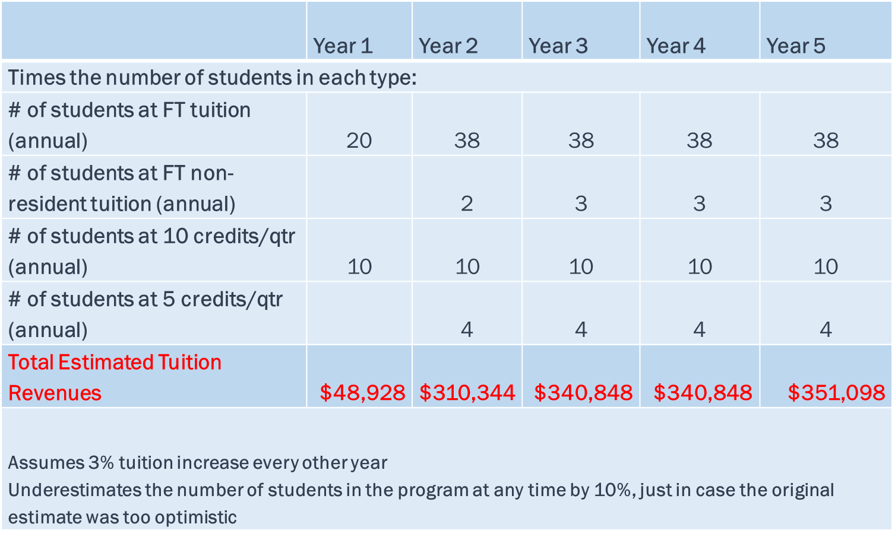

Slide 22
Challenges
      Program niche/strategic planning
      Associate and master’s level transitions
      Professional development
      Costs (i.e. library)
      Communication with four-year colleges/universities
      Program evolution & evaluation
      Research
      Marketing

Slide 23
research
Program Growth and Employment Outcomes of Washington’s Applied Baccalaureate Degrees (SBCTC Research Report 17-4 August, 2017)
Student Graduate Survey
Washington Roundtable Credential Pipeline Analysis Recommendation Discussions (2017, DRAFT)
Central Puget Sound Higher Education Capacity Study (2017, Jenée Myers Twitchell, Ed Taylor)
WSAC Roadmap
Cominole, M.B. (2017) Employment outcomes for graduates of Washington State’s applied baccalaureate degrees. (Dissertation)

Slide 24
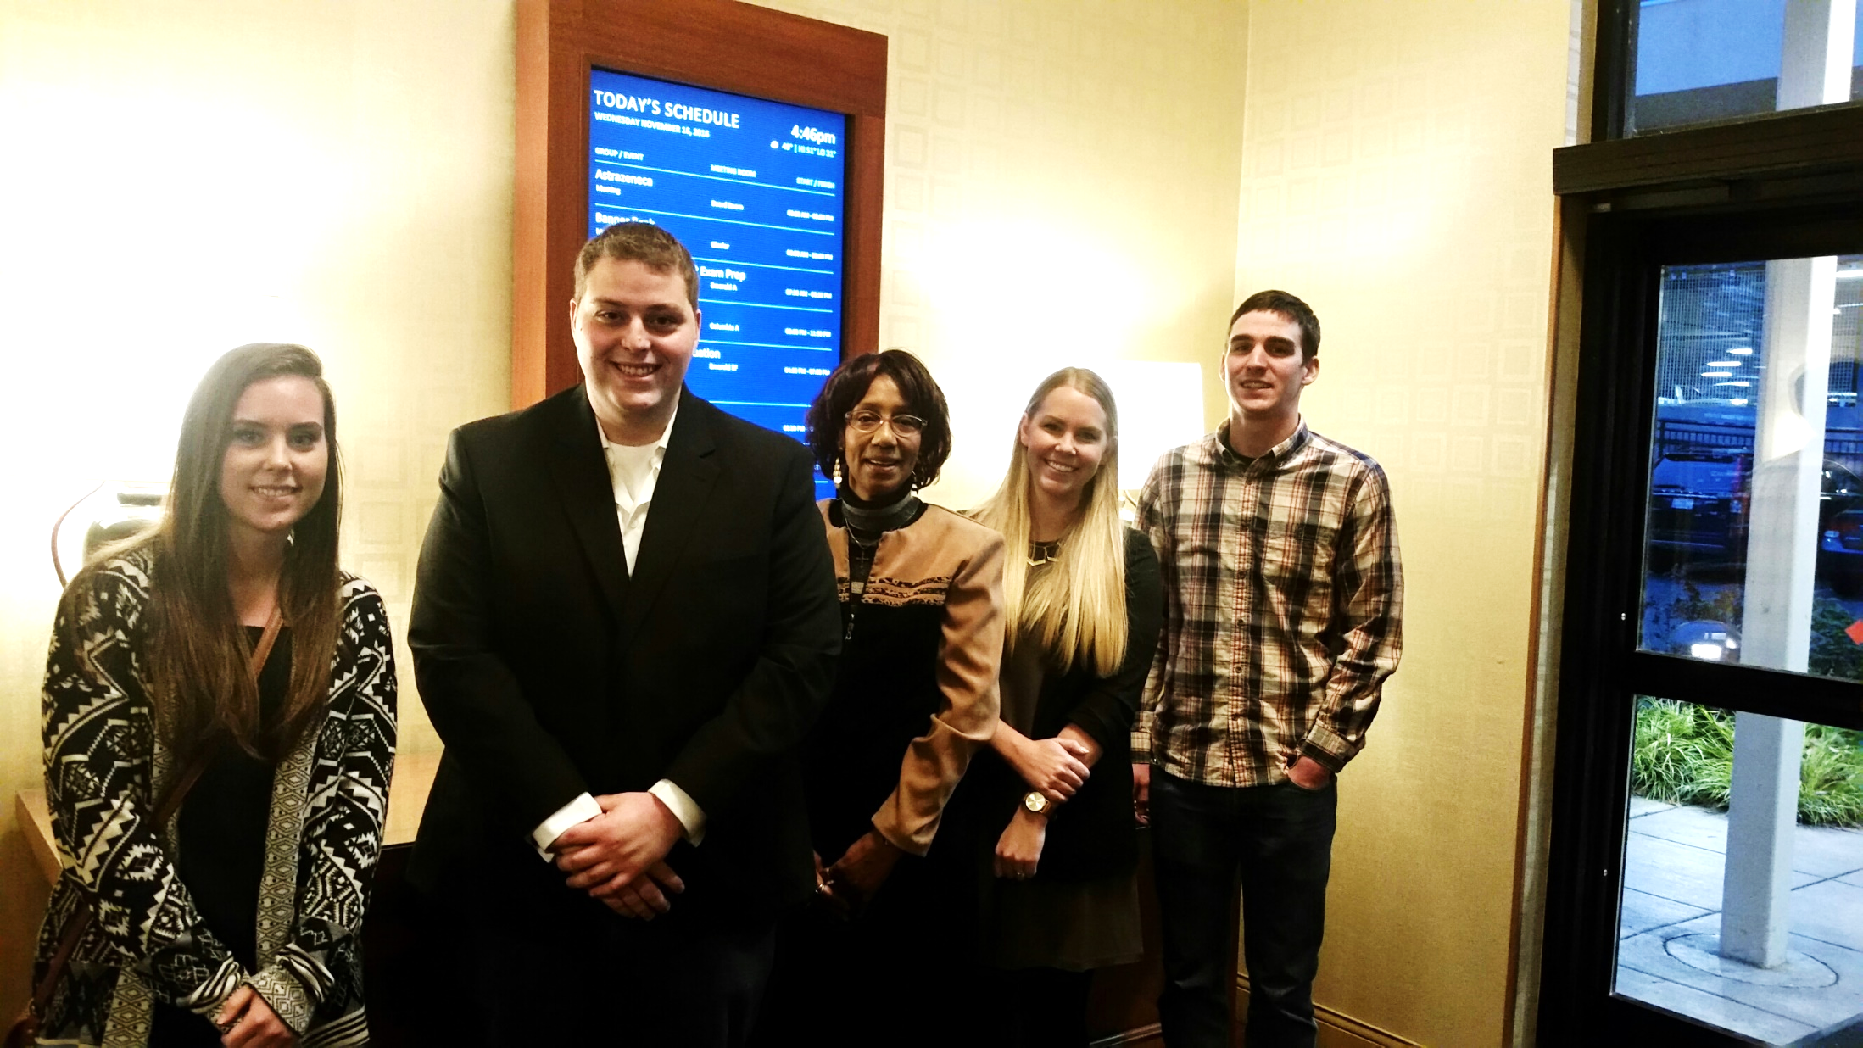

Slide 25
Who are our students?
Emily Fowler, BAS in Marketing and Entrepreneurship, Green River College
Michael Ruhl, BAT Applied Design, Lake Washington Institute of Technology
Patricia Rena Barnes, BAS in Behavior Science, Seattle Central College
Jana Ecklund, BAA Interior Design, Bellevue College
Justin Harris, BAS Diesel Technology, Centralia College
Notes:
Patricia Rena Barnes, BAS in Behavioral Science, Seattle Central College
Patricia Rena Barnes, a June 2016 graduate of the Bachelor of Applied Science in Behavioral Science at Seattle Central College, began her education pathway at Seattle Vocational Institute while in her 50s. She subsequently earned an associate’s degree in social and human services program before enrolling in and completing the applied baccalaureate degree. Patricia was recently accepted into a graduate program at the University of Washington’s School of Social Work where she aspires to eventually work as a family advocate outreach specialist. While at Seattle Central College, Patricia was a special inspiration to library staff, who created a scholarship to provide African-American single parents with financial support to continue their education and to honor her legacy at the college.
Emily Fowler, BAS in Marketing and Entrepreneurship, Green River College
Emily Fowler is a recent graduate of Green River College’s first graduating class in the Bachelor of Applied Science in Marketing and Entrepreneurship program. She was originally a student at the University of Washington but transferred to the more applied bachelor’s degree at Green River and used the skills she gained to accelerate her career. She currently is in a trades/sales marketing position and has strong family and friend ties to the area.
Justin Harris, BAS Diesel Technology, Centralia College
Justin Harris was born and raised in Centralia, earning his associate’s degree in diesel technology at Centralia College as a first generation college student, before completing his Bachelor of Applied Science in Diesel Technology in 2016. He is currently employed at Pape Machinery in Tacoma where he a shop technician. Though Justin struggled in high school and took time off before entering the diesel technology program, the BAS degree at Centralia provided the opportunity to earn a bachelor’s degree while remaining in the area where he worked two jobs while attending school.
Jana Ecklund, BAA Interior Design, Bellevue College
Jana Ecklund grew up in the Vancouver, WA area and moved to Seattle to attend the University of Washington where she graduated in 2011 with a bachelor’s degree in economics and history. While considering law school at one point and working at a law firm part-time, Jana pursued her passion for design by attending Bellevue College and earning a Bachelor of Applied Arts Interior Design degree in June 2016. Upon graduation, Jana received a position Urbanadd Architecture as an interior and project designer and working there has cemented her decision to switch careers later in her educational pathway.
Michael Ruhl, BAT Applied Design, Lake Washington Institute of Technology
Michael Ruhl is a 2015 graduate from Lake Washington Institute of Technology’s Bachelor of Applied Technology Applied Design degree. He is currently working as a mechanical drafter for Microsoft, helping to design high-profile equipment including the Surface Pro, Surface Book and the new Surface Studio. He started at LWTech in the Gateway to College Program, which serves 16-20-year-olds who have either dropped out of high school or are on the verge of dropping out. He earned a high school diploma and associate’s degree simultaneously.

Slide 26
Questions?
Applied Baccalaureate Degrees at SBCTC
www.sbctc.edu

