Slide 1
From AAS to BAS: Advising Alignment by MetaMajor
Katie Viola, Director of Student Development
Mike Potter, Dean of Instruction

Slide 2
Baccalaureate Education at LWTech
LWTech was approved as an expanded pilot college for BAS degrees in 2007
First students admitted 2009; BAS-Design cohort #10 just started
295 total graduates since 2011, 100 just last year
7 BAS degrees running Fall 2018. 11th just passed Statement of Need phase

Slide 3
LWTech’s 7 Current BAS Programs
Behavioral Healthcare
Dental Hygiene
Design
Digital Gaming & Interactive Media
Computing and Software Development
Public Health
Transportation, Logistics, and Supply Chain Management

Slide 4
By the Numbers
242 BAS students enrolled Fall 2018 in 39 upper division courses; up 34% from Fall 2017
Fall 2018 BAS qFTE=223.3, 7.4% of the college total (SBCTC system=1.8%)
BAS students are anticipated to contribute about $1.4 million in tuition & fees in 18-19
60% female, 31% students of color, 74% full time
100 of our BAS students are reported as “low income”
Persistence rates are 100% Fall to Winter and between 85%-93% after 5 quarters
Completion rates vary from 80% to 100%
Completion rates for students of color are 100% in almost all cohorts

Slide 5
Baccalaureate Education at LWTech
Baccalaureate Education is the responsibility of all employees at LWTech
In other words, all employees serve all students from Basic Skills through BAS
LWTech does not use a Program Manager model to provide services
Every support unit on campus includes BAS students in their service plans
Marketing, Recruiting, Admissions, Advising, Financial Aid, Tutoring, Help Desk, and so on all expanded their scope – (not always with money)
An example of coordination – All BAS admission applications are released at the same time (January) and due on the same date (Memorial Day). Criteria and policies are largely standardized and this year will include LWTech BAS eligibility requirements, along with individual program requirements.

Slide 6
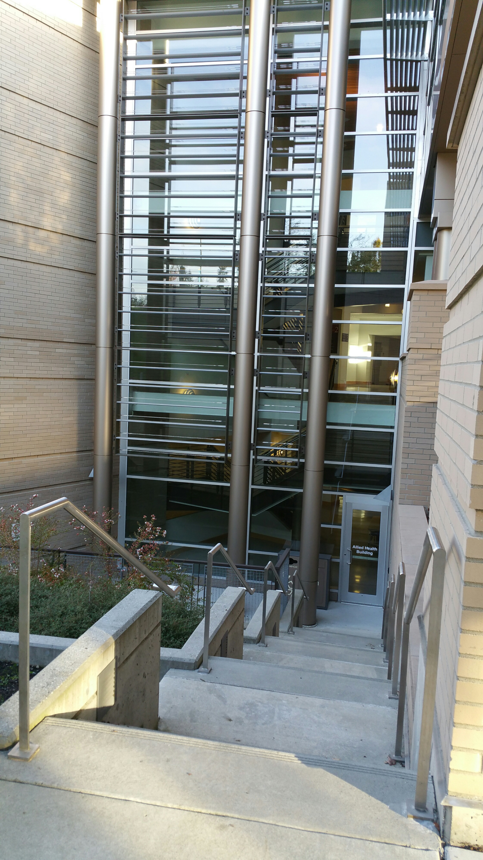
Advising
Let’s take a deeper look at how this works for Advising

Slide 7
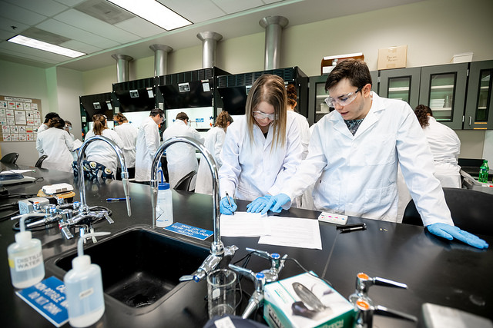
Meta Majors
Meta Majors
School of Business and Entrepreneurship (*)
School of Design & Applied Arts (**)
School of Engineering, Science, & Math
School of Health Sciences (***)
School of Information Technology (*)
School of Manufacturing
School of Transportation Technology
Culinary & Baking Arts
Environmental Horticulture
Early Childhood Education
* denotes BAS in meta major

Slide 8
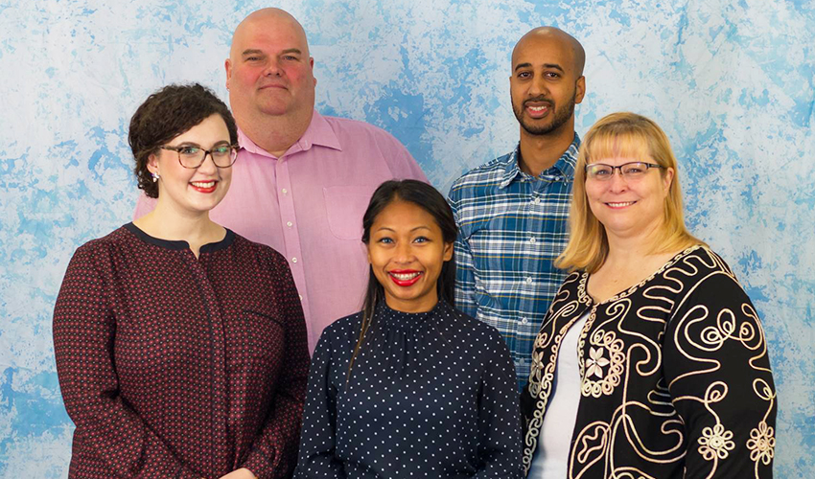
Advising Assignments
5 academic advisors
7 BAS programs in 4 meta majors

Slide 9
Caseload Examples
Lynne Szymanski Student Success Navigator Meta Majors:
School of Design & Applied Arts School of Information Technology
Architectural Technology
Design
Digital Gaming and Interactive Media
Civil Design
Computing & Software Development
Computer Security & Network Technology
Mechanical Design
Design BAS
Computing & Software Development BAS
Digital Gaming & Interactive Media BAS
Mony Loeum Coordinator of Disability Support Services and Advisor
Meta Major: School of Health Sciences
Behavioral and Social Services
Fitness Specialist/Personal Trainer
Medical Assisting
Medical Billing and Coding Professional
Public Health BAS
Behavioral Healthcare BAS

Slide 10
Pathway Advising Example
1) New Student Student declares Digital Gaming and Interactive Media AAS degree. Meets with Lynne for first quarter advising.
2) Persisting Student Student is taking Digital Gaming and Interactive Media AAS degree courses. Meets with Lynne throughout their program for advising.
3) Early Admission Student Student receives a letter stating they are qualified for an Early Action Plan to declare their interest in the Digital Gaming & Interactive Media BAS program. They ask Lynne for more information.
4) Completing Student Student continues in their courses, working with Lynne on the admission process for the BAS program. Student completes their AAS and is admitted to the BAS program.
5) BAS Student Student is admitted to the BAS program and works with Lynne and their faculty throughout the program for advising and resource support.
6) Graduating Student Student completes their Digital Gaming & Interactive Media BAS program!

Slide 11
Benefits for Students
“The model assist students by providing them with consistent person for support and guidance. There is rapport and trust built over the years. They are likely to stay because they have someone to talk to about issues with school or barriers outside of school. The consistent person is able to connect them with resources and person is able to see patterns and reach out if needed.” –Mony Loeum, Advisor
Consistent connection
Consistent advising information
Trust and rapport with advisor built over time
More likely to disclose barriers or concerns
Better referrals to resources
Earlier consideration of earning a Bachelor’s degree someday

Slide 12
Benefits for Faculty
“It helps me build connection with faculty because we are consistently (and frequently) talking about prospective and current students. We exchange ideas on how to help students. We have to communicate with each other in order to best support the student’s needs. It can be a beautiful thing when using the right strategies. When we are on the same page, the student is less confused.”
Consistent connection
Consistent advising information
More in-depth program knowledge
Trust and rapport built over time
More likely to share and collaborate on student concerns
Silos broken down from consistent communication
-Mony Loeum, Advisor

Slide 13
More from Faculty
I have interacted more often and more directly with my SSN this past year. It’s felt more like a partnership. I’ve been able to make requests, and we’ve shared information with one another about program circumstances and individual students. I have had opportunities to leave some advising responsibilities to my SSN, which has freed me up.
Students have two options (faculty and SSN), and clarity about whom to seek out. These two advisors have knowledge of the program, and clarity about its processes and curricula. It’s hard for messages to get turned around. Having two of us increases accessibility to students; one of us can meet a prospective student while the other has a busy week.
The current model works really well for me. Our success navigators are experts on the application process, while I focus on the program and course content. And having both the success navigators and instructors at the public information sessions, we can thoroughly cover whatever questions that may come up.
Thomas Abbott, Faculty Computing and Software Development BAS
Rex Rempel, Faculty Behavioral and Social Services BAS

Slide 14
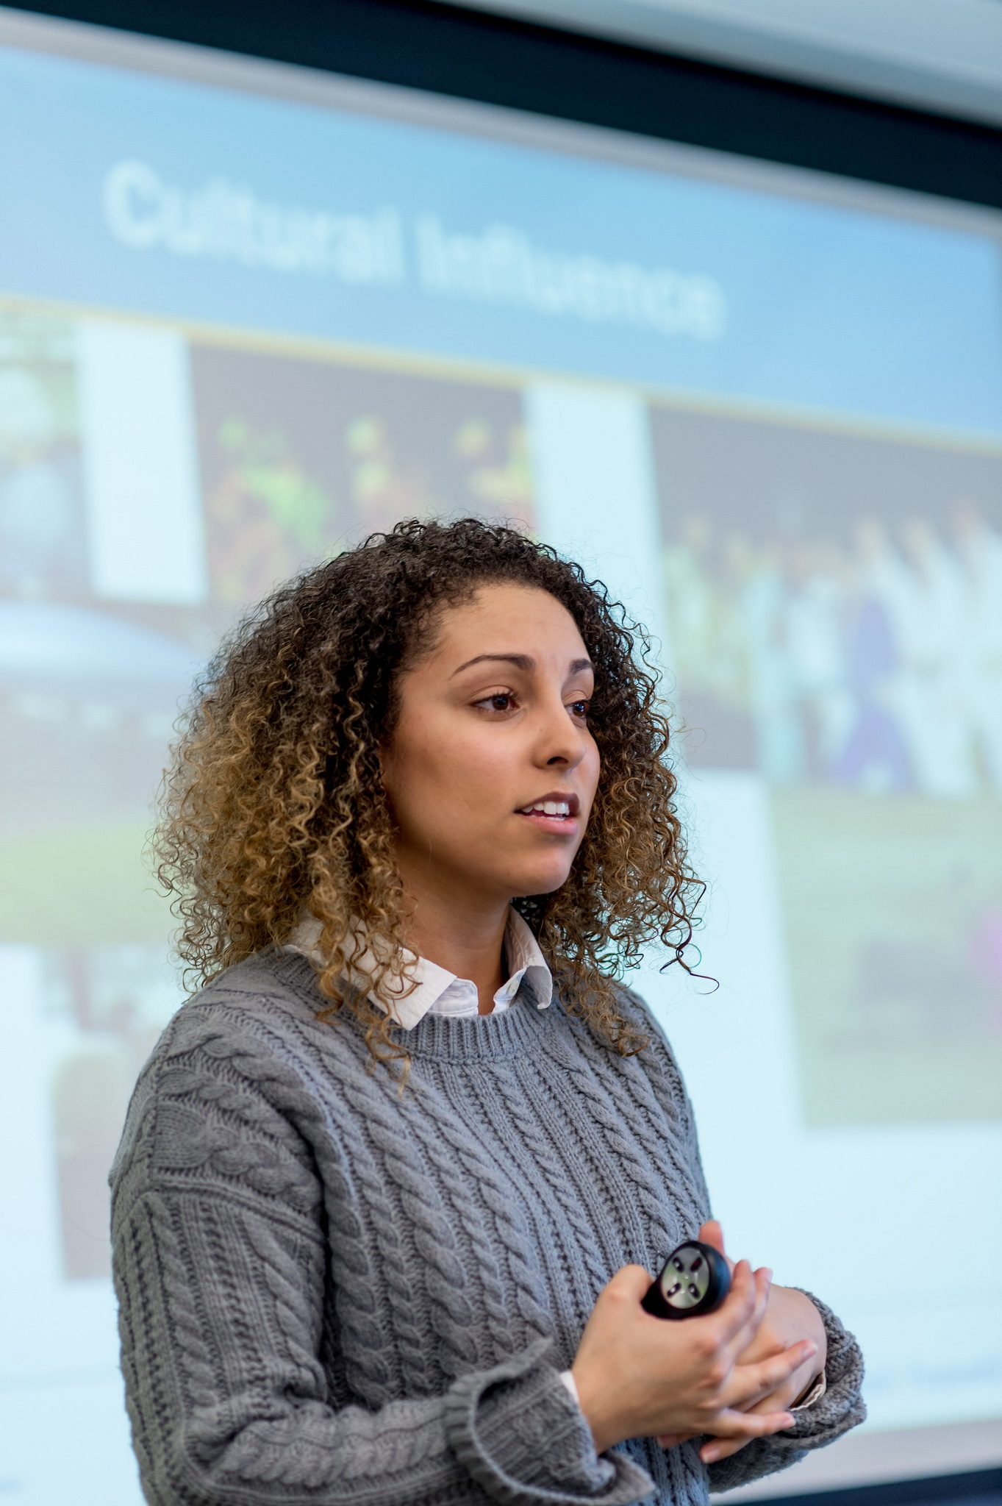
Challenges
Advising caseload sizes
Multiple people advising BAS programs, not a single point of contact (has it’s pros and cons)
Distributing information between advisors
TRiO, WorkForce, International, etc
Streamlining admissions processes
Re-directing resources to implement Advising plans to support growth in BAS enrollments

