Slide 1
BFET 101
Whatcom Community College started the BFET program in 2011 under the WorkFirst Director
Federal Food & Nutrition Service (FNS) funds
Grant contract through Dept of Social & Health Services (DSHS)
Grant administered through SBCTC as a third-party reimbursement system “The State”
By Monique Stefens
Notes:
CTCs are 80 to 85% of BFET caseload providers, CBOs are remaining 10+%
75% of BFET recipients are employed within 2 years.
DSHS cannot lift people out of poverty without partner agencies, private and public; this enhanced collaboration provides wraparound partnership and support services (childcare, food, etc.)
13 Federal agencies joined together in 2014 to fund career pathway programs & initiatives: USDA, D of Commerce, D of Defense, D of Education, D of Energy, HUD, D of Justice, D of Labor …

Slide 2
BFET program overview
Student must be:
US citizen
Financially eligible for Federal Basic Food benefits
Pursuing high school completion (HS21+), Adult Basic Ed (ABE), English language development (ESL), High School Equivalency (HSE/GED), or a professional/technical degree/certificate
Students in BFET program at WCC receive:
Waiver for 20 hour weekly work requirement for Basic Food eligibility through Department of Social & Health Services (DSHS)
Eligibility for childcare subsidies through Working Connections Childcare (WCCC)
Ongoing case management including pathway development, possible funding, non-monetary support/referrals, barrier navigation, connection to employment
Support bridging/collaborating with WorkFirst : BFET : Opportunity Council : Opportunity Grant : Worker Retraining : Division of Vocation Rehab : WorkSource (NWC) programs

Slide 3
BFET funding overview
BFET does not have any up-front grant funding; invoicing occurs at the end of each quarter. BFET is a national program piloted in Washington State, heralded as a model across the US. It is described as innovative and complex, is flexible, and has strict Federal & State compliance regulations. BFET fiscal year starts October 1st each year and is not directly tied to student FTE.
BFET income is generated from reimbursement of eligible expenses paid from non-Federal sources; this is referred to as 50% reimbursement funds or “matching.” BFET first expends 100% of the cost of program operations, then bills at 50% for reimbursement. Since some of the expenditures are directly from the State (grants), the reimbursements generate income.
If BFET funding is not fully awarded nationally, unawarded funding is offered to existing BFET programs for expenditure within one quarter. These funds are called 100% funds, must be spent on tuition & fees only, restricted to expenditures on current BFET-enrolled students. WCC BFET typically receives limited 100% funds annually.
Reutilized funding began in 2016, which allows matching previously billed to be re-matched for subsequent reimbursement, also called “local match.” WCC BFET reutilizes funds for BFET salaries to yield a net zero cost to WCC for program salaries.
Notes:
The BFET grant is described as having “administrative complexities” by all partner agencies.
When BFET spends 100% of non-federal funds upfront and requests 50% reimbursement – that reimbursement (if it doesn’t go back to the original funding source) then becomes the amount available to reutilize. If spent salary/benefits with non-federal funds and are requesting reimbursement for 50% of them then they are already included in the reutilized funds available.

Slide 4
How BFET reimbursement works
BFET administrator adds B! Unusual Action Code to Minisoft prior to AutoApp/cashiering each quarter
The WCC financial aid office staff run a report to identify all students registered for an upcoming quarter with an unusual action code of B!, then manually post State Need Grant and other non-Federal funds before Pell.
The WCC Senior Business Accountant runs a quarterly tuition report to identify all students from the previous quarter that received BFET-matchable funding toward their tuition & fees.
The BFET administrative staff verifies BFET student matching eligibility through billing roster process, other grant expenses through Match Certification form.
The WCC Senior Business Accountant runs a quarterly salary report to invoice matchable staffing costs.
BFET staff completes BFET invoicing with WCC Senior Business Accountant.
BFET funds are reimbursed and held in account.
The FY 16 BFET budget is $158,810, which is the amount reimbursed from 50% of $317,620 eligible expenses. WCC was awarded an additional $15,000 in 100% funds, bringing the FY16 BFET grant to a total of $171,810. Of the 100% funds awarded in FY16, $6,600 reimbursed WCC indirect.

Slide 5
Where BFET funds are distributed
BFET student expenses to provide access, retention and completion
Tuition assistance, textbooks, Solutions Fund, bus passes
Emergency Fund for general WCC student retention and completion
WRT/Opp Grant bridges for student funding across academic program
Veterans to provide access, retention and completion
Running Start students (heightened restrictions)
Whatcom Dream & Gateway scholarships (no longer eligible expenditure)
Baker computer lab (one-time expenditure)
Learning Center
Transitional Learning instruction pilot, GED exam fees
Reimburse 063 1C02 for BFET salaries
BFET travel, copies and supplies

Slide 6
BFET money flow
For every dollar spent on a BFET-eligible student, 50₵ can be invoiced by the BFET program at their school for additional training & support. This is what is known as 50% matching.
These funds are then used to provide services to increase access, progression, retention and training completion via scholarships, coaching and pathway development.
This is a self-supported program; BFET salaries come entirely from the BFET funds generated through BFET matching.

Slide 7
BFET visual money flow
Example: $64,000 quarterly tuition spent on BFET students
50% ($32,000) of that quarterly tuition is invoiced to SBCTC
50% paid to WCC BFET by SBCTC as “interest” in building BFET student skills
Example: $32,000
Example: $37,000
Funding available for BFET students
State funds*
50% reimbursed to WCC BFET by SBCTC
Example: $5,000
BFET account
Salary reimbursed to WCC, with net zero cost to WCC
Salaries
Example: $10,000
*State funds include tuition from College Bound, SNG, Early Achievers, Opportunity Grant and
other funding awarded to WCC students that are enrolled in the BFET program. The State is
leveraging Federal funds to provide reimbursement matching for State and local dollars spent.

Slide 8
BFET accounting details
All 50% BFET matching funds are held in 111-3FFT
Salary matches may include:
063-1C02 BFET & Advising code
062-1C17 Opportunity Grant
018-NF01 Transitional Learning
061-1C13 Worker Retraining
All 100% Tuition funds are issued through 111-3FET
For both accounts, the grant money is awarded, WCC disburses the funds, invoices for those disbursements and is reimbursed.
Notes:
*WCC uses FAPC, three-digit codes that almost always match their two-digit award code counterpart (example 0ZD is the FAPC code, ZD is the award code)
Current BFET balance is approximately $84,000, including BFET invoicing reimbursement through winter quarter and reimbursement of BFET salaries.
BFET administrator contacts Senior Business Accountant to verify salary reimbursement occurs and is accurate.
BFET administrator tracks Time & Effort reporting and keeps T&E on file.

Slide 9
BFET accounting details
BFET Financial Aid Payment Codes* may include:
0X1 for 100% tuition, connected to account 111-3FET, award disbursement code 2
0X2 for Dream scholarship, no longer an eligible expenditure, award disbursement code 1
0X0 for Special Assistance , award disbursement code 3
0X3 for Tuition Assistance, award disbursement code 2
0X6 for Gateway & Dream, no longer an eligible expenditure, award disbursement code 1
BFET FAPC matchable codes include:
0ZD Opportunity Grant
009 State Need Grant
0TF Workforce Training
0EA Early Achievers Opportunity Grant tuition
0FD WCC Foundation scholarships
037 WA Scholars
039 WAVE recipient
054 WCC Grant
070 Outside/local scholarship
01C College Bound scholarship
WCC Bookstore processes payment for textbooks and bus passes through 111-3FFT quarterly
Notes:
*WCC uses FAPC, three-digit codes that almost always match their two-digit award code counterpart (example 0ZD is the FAPC code, ZD is the award code)
Current BFET balance is approximately $84,000, including BFET invoicing reimbursement through winter quarter and reimbursement of BFET salaries.
BFET administrator contacts Senior Business Accountant to verify salary reimbursement occurs and is accurate.
BFET administrator tracks Time & Effort reporting and keeps T&E on file.

Slide 10
Financial aid disbursement sent to WCC for eligible student
WCC posts 100% of award to student account
BFET invoices SBCTC 50% of the eligible award
DSHS verifies student BFET eligibility, SBCTC reimburses WCC BFET
WCC BFET covers program operational costs
WCC BFET provides funding to eligible students
WCC provides mentorship, coaching and case management to BFET students
Students receive help navigating barriers & accessing resources
Students receive funding to access education and complete goals

Slide 11
Strategies to leverage BFET funding
Every BFET-matchable dollar returns 50%
Match tuition wherever possible to decrease salary matching to position WCC to be a strong candidate for increased grant allotment
Decrease salary matching for T&E simplification and to reduce cost per student within grant
Leverage reutilized funding to match salaries; reutilization is repeatable
Worker Retraining is 100% matchable as reutilized funds

Slide 12
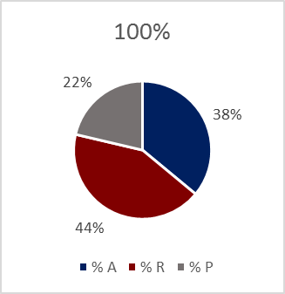
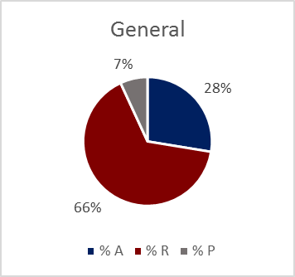
FY16 BFET student expenditures
Expenditures to students between college-level programs (71%) and basic education (HS21+, ABE, ELL) 29%
College-level funding typically helps retention and completion
100% Tuition dollars
50% “matching” dollars
Completion
Completion
Access
Access
Retention
Retention

Slide 13
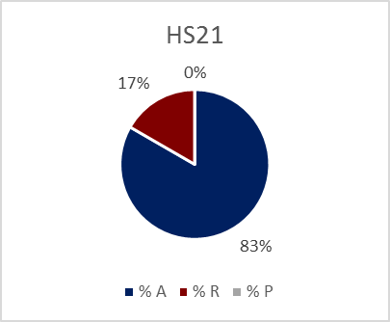
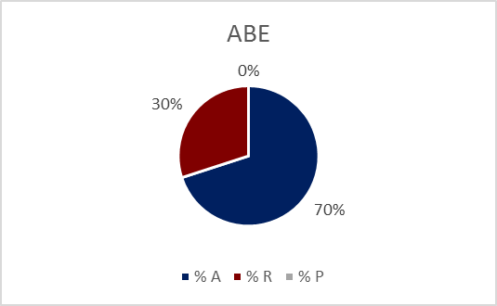
FY16 BFET student expenditures
Basic education funding typically creates access to education and progression to college level coursework
Retention
Access

Slide 14
FY16 BFET student expenditures, student demographics
Students that received funding in FY16 have the following demographics:
14.3% receive accommodations
62.9% are first generation college students
42.9% are students of color
Their average age is 33 years old

Slide 15
BFET student demographics overall
Notes:
OVERALL BFET demographics, not only BFET-funded students

Slide 16
Questions?
Contact Monique Stefens
(360) 383-3183
mstefens@whatcom.ctc.edu
LDC134B
Thank you.

