Slide 1
How we explain what BFET is to expand organizational support
By D. Monique Stefens

Slide 2
“BFET is a matching grant”

Slide 3
“BFET reutilizes funds”

Slide 4
“BFET makes a difference”

Slide 5
BFET 101
Federal Food & Nutrition Service (FNS) funds
Grant contract through Dept of Social & Health Services (DSHS)
Grant administered through SBCTC as a third-party reimbursement system “The State”
Notes:
CTCs are 80 to 85% of BFET caseload providers, CBOs are remaining 10+%

Slide 6
BFET funding overview
BFET does not have any up-front grant funding, it is a reimbursement program.
BFET fiscal year starts October 1st each year and is not directly tied to student FTE.
BFET income is generated from reimbursement of eligible expenses.
The FY 16 BFET budget is $158,810, which is the amount reimbursed from 50% of $317,620 eligible expenses.
WCC was awarded an additional $15,000 in 100% funds, bringing the FY16 BFET grant to a total of $171,810.
Notes:
When BFET spends 100% of non-federal funds upfront and requests 50% reimbursement – that reimbursement (if it doesn’t go back to the original funding source) then becomes the amount available to reutilize. If spent salary/benefits with non-federal funds and are requesting reimbursement for 50% of them then they are already included in the reutilized funds available.

Slide 7
BFET program overview
Student must be:
US citizen
Financially eligible for Federal Basic Food benefits
Pursuing high school completion (HS21+), Adult Basic Ed (ABE), English language development (ESL), High School Equivalency (HSE/GED), or a professional/technical degree/certificate
Students in BFET program at WCC receive:
Waiver for 20 hour weekly work requirement for Basic Food eligibility through Department of Social & Health Services (DSHS)
Eligibility for childcare subsidies through Working Connections Childcare (WCCC)
Ongoing case management including pathway development, possible funding, non-monetary support/referrals, barrier navigation, connection to employment, academic coaching
Support bridging/collaborating with WorkFirst : BFET : Opportunity Council : Opportunity Grant : Worker Retraining : Division of Vocation Rehab : WorkSource (NWC) programs : Co-Op 190

Slide 8
BFET money flow
For every dollar spent on a BFET-eligible student, 50₵ can be invoiced by the BFET program at their school for additional training & support. This is what is known as 50% matching or leveraging.
These funds are then used to provide services to increase access, progression, retention and training completion via scholarships, coaching and pathway development.
This is a self-supported program; BFET salaries come entirely from the BFET funds generated through BFET matching.

Slide 9
BFET visual money flow
Example: $64,000 quarterly tuition spent on BFET students
50% ($32,000) of that quarterly tuition is invoiced to SBCTC
50% paid to WCC BFET by SBCTC; interest in building BFET student skills
Example: $37,000
Example: $32,000
Funding available for BFET students
State funds
Salary reimbursed to WCC, with net zero cost to college
50% reimbursed to WCC BFET by SBCTC
Example: $5,000
BFET account
Salaries
Example: $10,000
By D. Monique Stefens
Notes:
*State funds include tuition from College Bound, SNG, Early Achievers, Opportunity Grant and
other funding awarded to WCC students that are enrolled in the BFET program. The State is
leveraging Federal funds to provide reimbursement matching for State and local dollars spent

Slide 10
Financial aid disbursement sent to WCC for eligible student
WCC posts 100% of award to student account
BFET invoices SBCTC 50% of the eligible award
DSHS verifies student BFET eligibility, SBCTC reimburses WCC BFET
WCC BFET covers program operational costs
WCC BFET provides funding to eligible students
WCC provides mentorship, coaching and case management to BFET students
Students receive help navigating barriers & accessing resources
Students receive funding to access education and complete goals

Slide 11
Connect BFET program to strategic plan
Goal 1: Expand opportunities for students to achieve their potential.
Increase access for diverse and nontraditional student populations.
Introduce new opportunities for student learning and engagement.
Goal 4: Advance the College as a more diverse learning community.
Increase access for underrepresented populations.

Slide 12
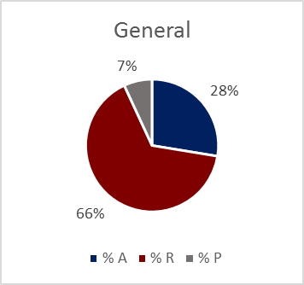
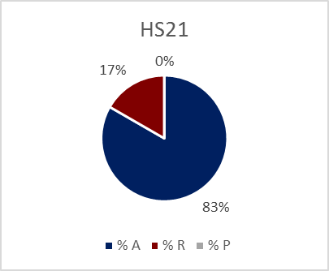
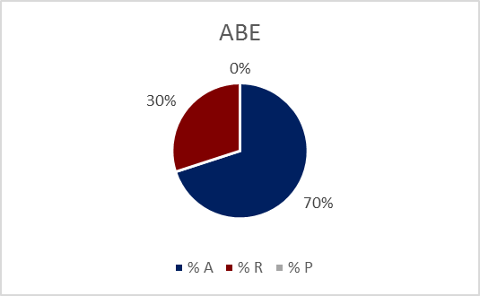
Show BFET expenditures
Funding for access, retention and completion

Slide 13
Show expenditures : student demographics
Students that received funding have the following demographics:
14.3% receive accommodations
62.9% are first generation college students
42.9% are students of color
Their average age is 33 years old

Slide 14
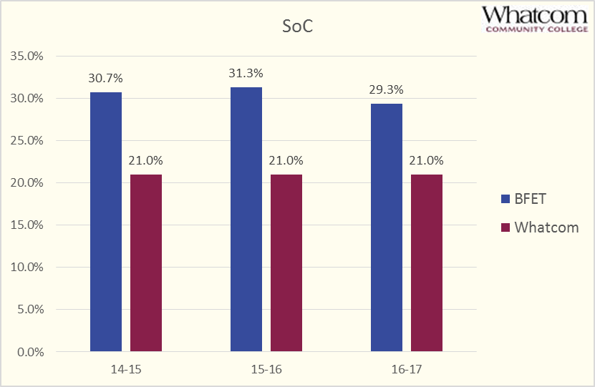
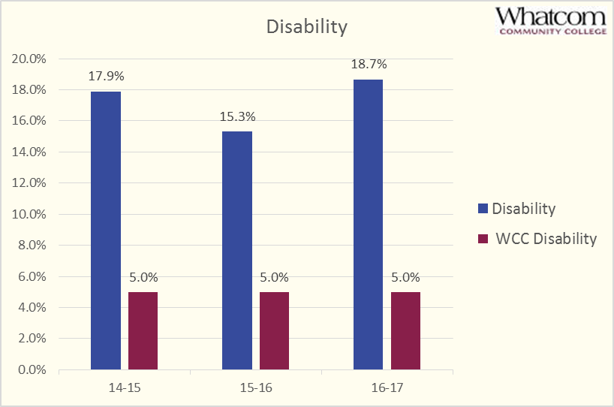
Show BFET population

Slide 15
expanded Understanding led to:
Increased referrals from advisors
Increased referrals from faculty
Improved leveraging across workforce programs
Improved strategy with administration

