Slide 1


Creating a Cross-Institutional Equally Effective Alternative Access Plan (EEAAP) Process: CSU and CCCs
Leon McNaught
Director – Digital Accessibility & Equity
California State University Office of the Chancellor
Tom Siechert
Procurement Accessibility Specialist
California Community Colleges Technology Center

Slide 2
Session Objectives
EEAAP origins and legal framework
Review EEAAP process and role in accessible procurement
Common gaps in existing EEAAPs
New process outcomes to address EEAAP quality
Benefits of CSU and CCC collaboration
Real-world examples
Communication and ensuring EEAAPs remain dynamic
2

Slide 3
Session Abbreviations
ICT – Information Communication Technology
WCAG - Web Content Accessibility Guidelines
EEAAP – Equally Effective Alternative Access Plan
ACR – Accessibility Conformance Report
DOJ – Department of Justice
OCR – Office of Civil Rights
ADA – Americans with Disabilities Act
504, 508 – Sections of the Rehabilitation Act of 1973
3

Slide 4
Accessible Procurement Framework
Gather Accessibility Conformance & Product Info
Prioritize/Triage Review Activities
Validate Accessibility Barriers
Communicate info to end-users
Collaborate with Vendors
Create EEAAP (Blockers)
4

Slide 5
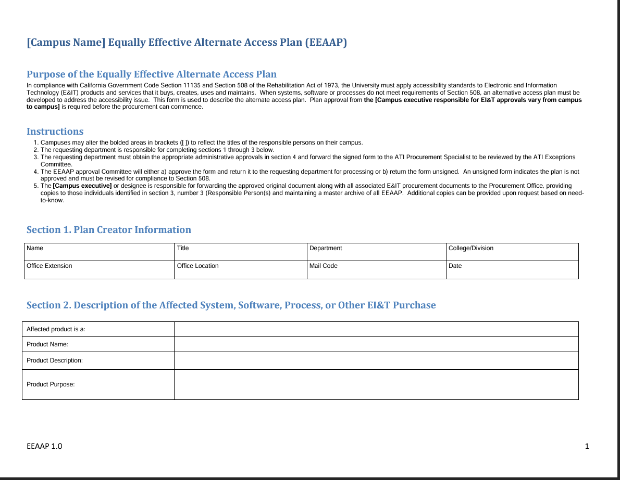
EEAAP Origins & Legal Framework
Section 508 Legal Requirements
  Best Meets (E202.7)
  Required Documentation (E202.7.1)
  Alternative Means (E202.7.2)
Equally Effective Alternative Access Plan Template & Process
  Created by CSU system in 2010
  Adopted by many Colleges in U.S.
5

Slide 6
Prerequisites to create an EEAAP
Validate accessibility barriers
ACR Critical Review
Live Product Accessibility Demo
Automated Testing
Manual Testing
User Testing
Determine if Blockers Exist
Identify impact for specific User Group(s)
6

Slide 7
Challenges in Existing EEAAP Process
Not an EEAAP
Lack of communication/
distribution
EEAAPs for all purchases
Bureaucratic exercise
No barrier validation
7

Slide 8
Key EEAAP Components
Alternative Means of Access
Functional Barriers (Blockers)
Communication Plan
8

Slide 9
EEAAP Legal Requirements
Availability
Same Services, Info, Benefits
No Extra Work
Independence
Equivalent Ease of Use

Slide 10

Is an EEAAP an EEAAP if no one knows it exists?
10

Slide 11
CSU CCC Collaboration:
A New EEAAP Process
Guided, Measurable, Consistent, Repeatable, Meaningful
11

Slide 12
New EEAAP Process Walkthrough
ICT Product Information
Referenced Documentation
Accessibility Barriers (Blockers)
Alternative Means of Access
Legal Requirements
Communication & Distribution
Affected User Groups
Accessibility Statement
Alternative Access Outcome
Administrative Approvals
12

Slide 13
New EEAAP Process Outcomes
Risk Assessment
Equally Effective Alternative Access
Non-Equal Alternative
Individualized Accommodations
Interpretation
13

Slide 14
Real-World Examples of Three Outcomes
Title IX Web Training
Library Databases & Resources
Athletic Ticketing App
14

Slide 15
Example 1 – Title IX Web-Based Training
Alternative Means of Access
Quality | Risk Assessment: 5 of 5
Provides access to same information
Matches availability of primary solution
Enables independent access
No disparate burden/impact on user
Substantially equivalent ease of use
Outcome: EEAAP
Re-created vendor content with alternative media, access to content controlled via password authentication
Background:
  Legally Mandated Training - Violence Against Women Act (VAWA)
  Negative consequences if students didn't complete by deadline
  Sensitive Subject Matter
15

Slide 16
Example 2 – Athletic Ticketing Web App
Alternative Means of Access
EEAAP stated students could call a phone number, during University hours (8am-5pm), Monday-Friday, and a box office staff member would help them complete the purchase.
Quality | Risk Assessment: 2 of 5
Provides access to same information
Matches availability of primary solution
Enables independent access
No disparate burden/impact on user
Substantially equivalent ease of use
Outcome: Non-Equal Alternative
Background:
  Web-based ticketing application for College athletic events
  Available 24x7x365 via web
  Self-service app enabled students to quickly buy best or cheapest tickets
16

Slide 17
Example 3 – Library Database / Resources
Alternative Means of Access
Develop system to allow students to schedule time with research librarian to navigate inaccessible resources
Establish means for students to submit inaccessible resources for timely conversion to accessible formats
Quality | Risk Assessment: 0 of 5
Provides access to same information
Matches availability of primary solution
Enables independent access
No disparate burden/impact on user
Substantially equivalent ease of use
Outcome: Individualized Accommodations
Background:
  Visually impaired students could not independently access or use:
    Library Databases
      Relied on sighted individuals to help
      Restricted independence
      Lack of timely access to resources
    Library Website
      Web-Content management system (front-end for library databases)
17

Slide 18
Ensuring EEAAPs Remain Dynamic
Coordinate review along with ICT renewal
Emphasize that EEAAPs are temporary and ensure vendor commitment to address barriers with a roadmap, contract language, etc.
18

Slide 19

Questions?
Leon McNaught: lmcnaught@calstate.edu
Tom Siechert: tsiechert@ccctechcenter.org

